Slide 1
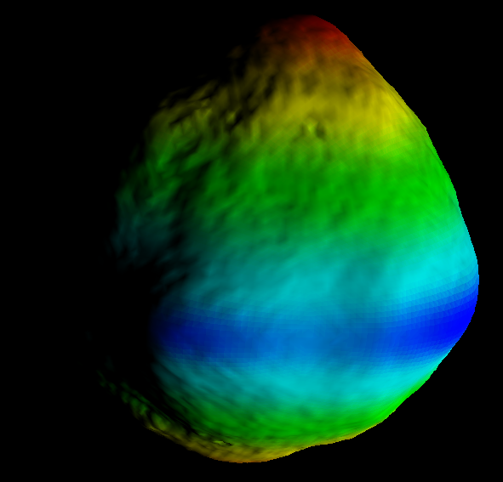
Small Body Mapping Tool
Tutorial
Olivier Barnouin, Russell Turner, Philip Twu, Lillian Nguyen, Michael Zimmermann
Johns Hopkins University Applied Physics Laboratory

Slide 2
Overview
Architecture of Small Body Mapping Tool (SBMT)
Tutorial guiding you through how to start up and use the SMBT including a discussion of
  General features of the tool
  Case study of the NEAR landing site

Slide 3
SBMT Architecture
Overview
The SBMT consists of 2 parts:
  SBMT Client
  SBMT Server

Slide 4
SBMT Client
The SBMT client is a program that runs on the desktop and communicates with the server to download data and perform queries.
Written in the Java (version 8) programming language for cross platform support
Uses additional 3rd party libraries:
  VTK (http://vtk.org) for 3D visualization
  Apache Commons Math for some mathematical procedures
  JFreeChart for plotting
Additional Components
  Bob Gaskell’s Mapmaker tool (in Fortran; about to converted to Bigmaps)
  Implementation (in C++) of algorithms for computing the gravity of a general polyhedron (either Werner and Scheeres or Cheng et al).

Slide 5
SBMT Client Requirements
Supported on:
  Mac OS X (10.5 or later)
  Windows (Window 7)
  Linux (most recent distributions)
The tool works best with
  lots of memory
  lots of bandwidth
  good graphics card

Slide 6
SBMT Server
The server consists of 2 components
  A web server with PHP support
  A MySQL database for storing metadata of images, spectra.
  Judicious file structure for lidar datasets.
SBMT client can be configured to point to a server at different location
Searched data is cached on users local machine and only downloaded again if updated on the server
Currently over 2 TB of data on server
Much of data is publically available on PDS

Slide 7
Available Datasets
Gaskell Shape Models
  Bennu: Nolan, 2 truth models (4 not yet ready). Mapcam, Polycam images for all phases of the DRM Rev C for shape model 3; OLA data
  Eros: MSI, NIS, and NLR, Gaskell maplets
  Itokawa: AMICA, and LIDAR
  Vesta: FC
  Ceres (for Dawn team only): FC
  Bennu: Gaskell maplets
  Phoebe
  Mimas
  Phobos
  Pluto, Charon, Nix, Hydra
Thomas shape models
Stooke shape models
Hudson (radar) shape models
Details of origin are listed in the help section of SBMT

Slide 8
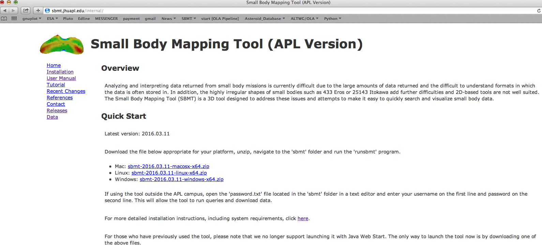
Obtaining the Small Body Mapping Tool
Click on appropriate file
Open
  http://sbmt.jhuapl.edu/internal/
Outside APL, enter your username and password in password.txt file (similar to license file) in same directory where you keep your SMBT application or put it in the hidden ./neartool
  Mac and linux users: ~/.neartool
  PC users: C:\Users\<username>\.neartool
You will need Java 8 or higher installed on your computer
Read the Download and Installation page for system requirements and detailed installation information.

Slide 9
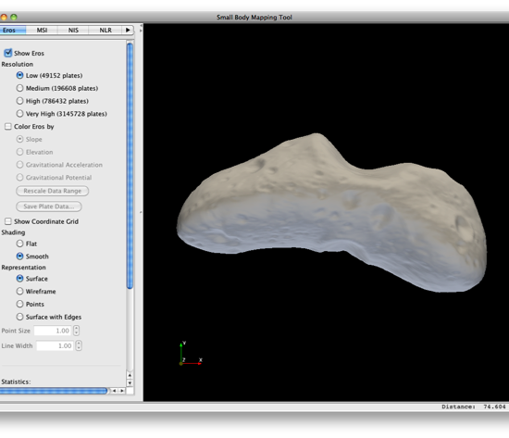
The Basics
Control panel
The tool is divided into 2 main parts: A renderer panel on the right and control panel on the left. The renderer panel displays data in 3D and the control panel is used to control what gets displayed in the renderer.
In addition, there is a menu bar on top with additional options and a status bar on the bottom
Status bar
Renderer panel

Slide 10
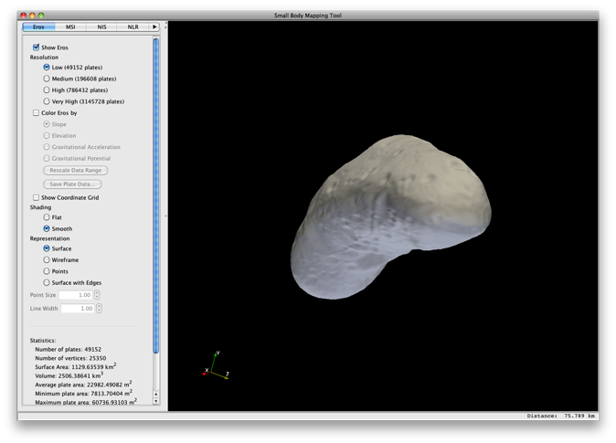
Rotating Shape Model
In the renderer view, rotate the asteroid by dragging the mouse while holding down the left mouse button.

Slide 11
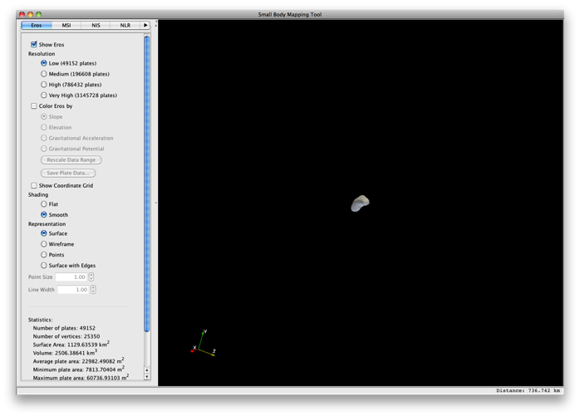
Zooming in and out of
the Renderer
There are 2 ways to zoom in and out of the renderer.
Use the mouse wheel
Drag the mouse in the upward direction while holding down the right mouse button to zoom in. Drag the mouse in the downward direction while holding down the right mouse down to zoom out.

Slide 12
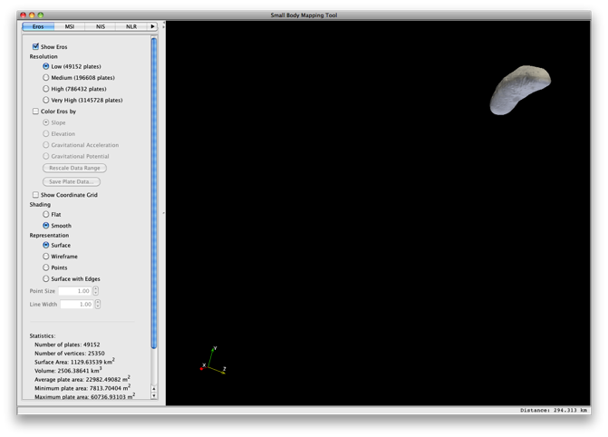
Panning the Shape Model
Panning moves the shape model sideways without rotating it.
To pan, drag the mouse while holding down the middle mouse button or hold shift button and drag

Slide 13
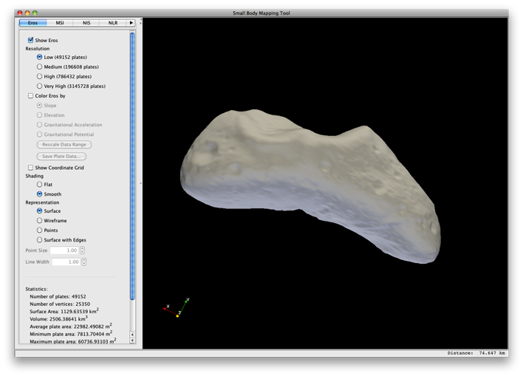
Spinning the Shape Model
Spinning rotates the shape model around an axis that points into the center of renderer view.
To spin, drag the mouse while holding down the left mouse button and the control key.

Slide 14
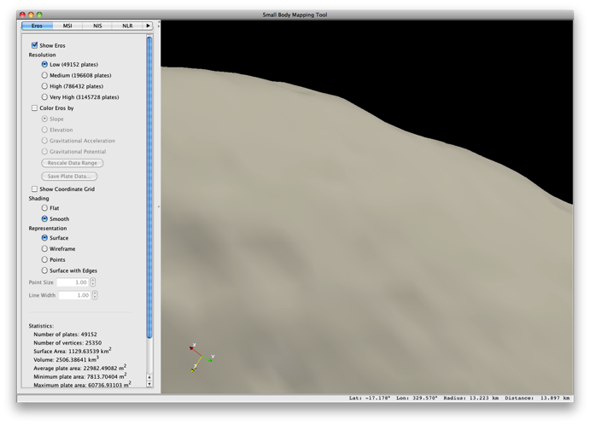
Change Center of Rotation
By default when rotating the camera (while dragging with left mouse button), the shape model rotates around the center of the shape model.
To rotate around a different point on the shape model, position the mouse over that point and press the ‘c’ key.
To return to the default center of rotation, press the ‘r’ key (for reset).

Slide 15
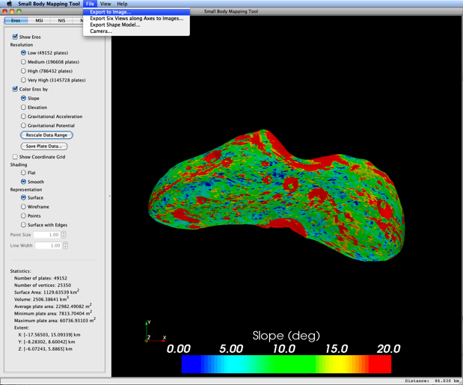
Save renderer view
as image
Click on the “Export to Image…” in the File menu. Choose a format and name for the image.

Slide 16
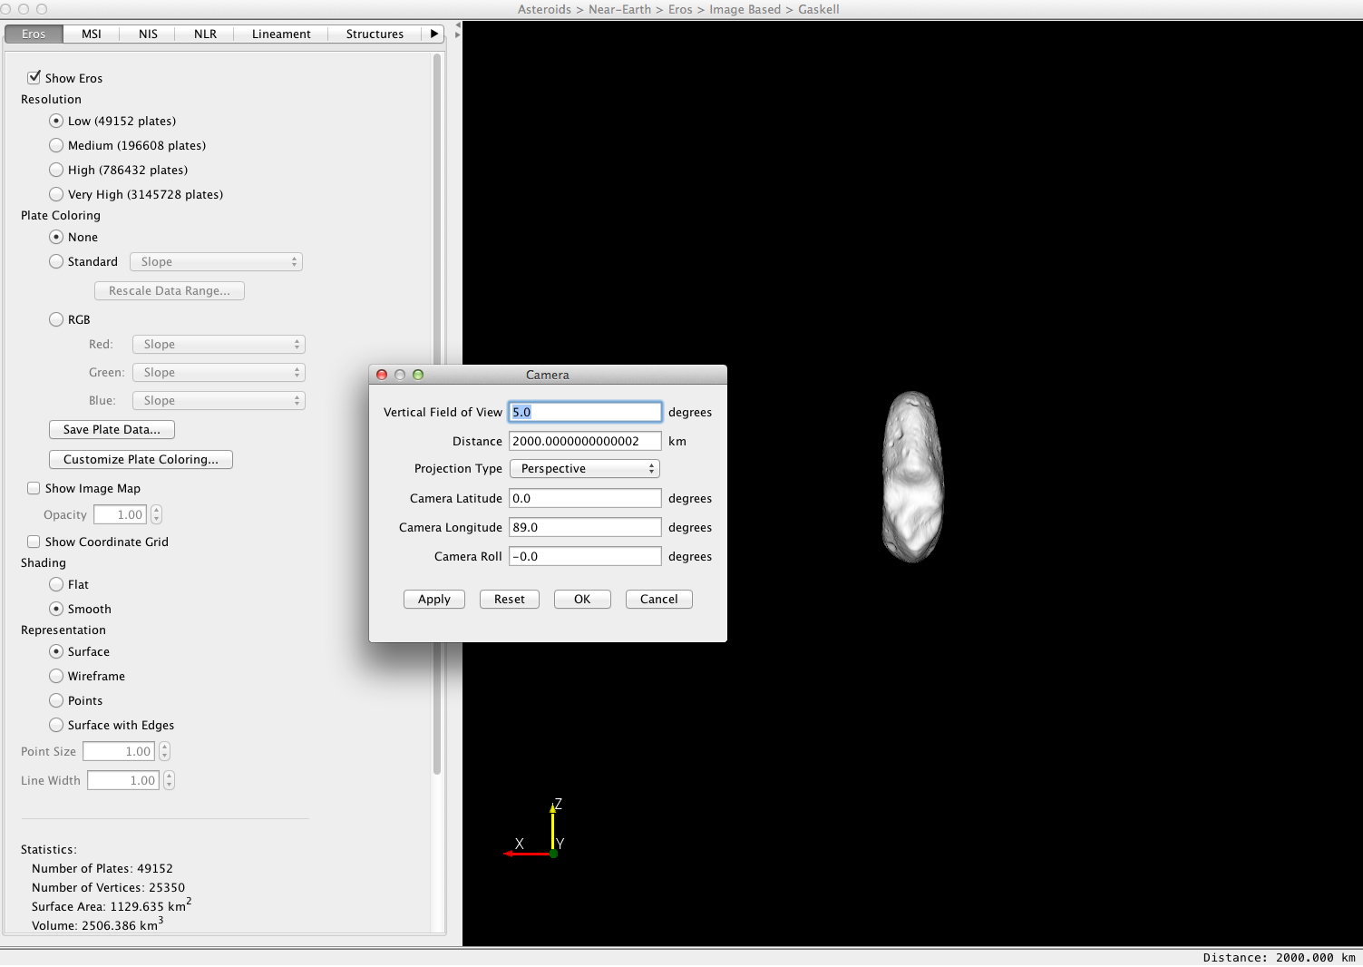
Change Camera Vertical Field of View and Distance
By default the vertical field of view of the camera is 30 degrees and the distance is chosen so the entire shape model fits in the renderer view.
To change these values, open the Camera… dialog in the File menu.
Enter a field of view of 5 degrees.
Enter a distance of 2000 km.
Then click OK

Slide 17
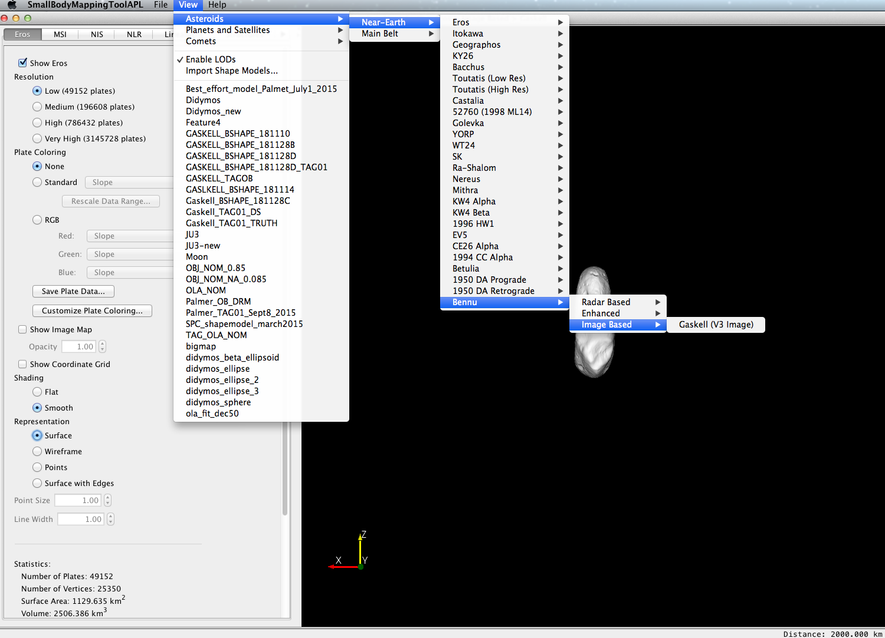
Go to Bennu V3 Data
In the View menu, click on the Asteroids -> Near-Earth-> Bennu-> Image Based -> Gaskell (V3 Image) option.

Slide 18
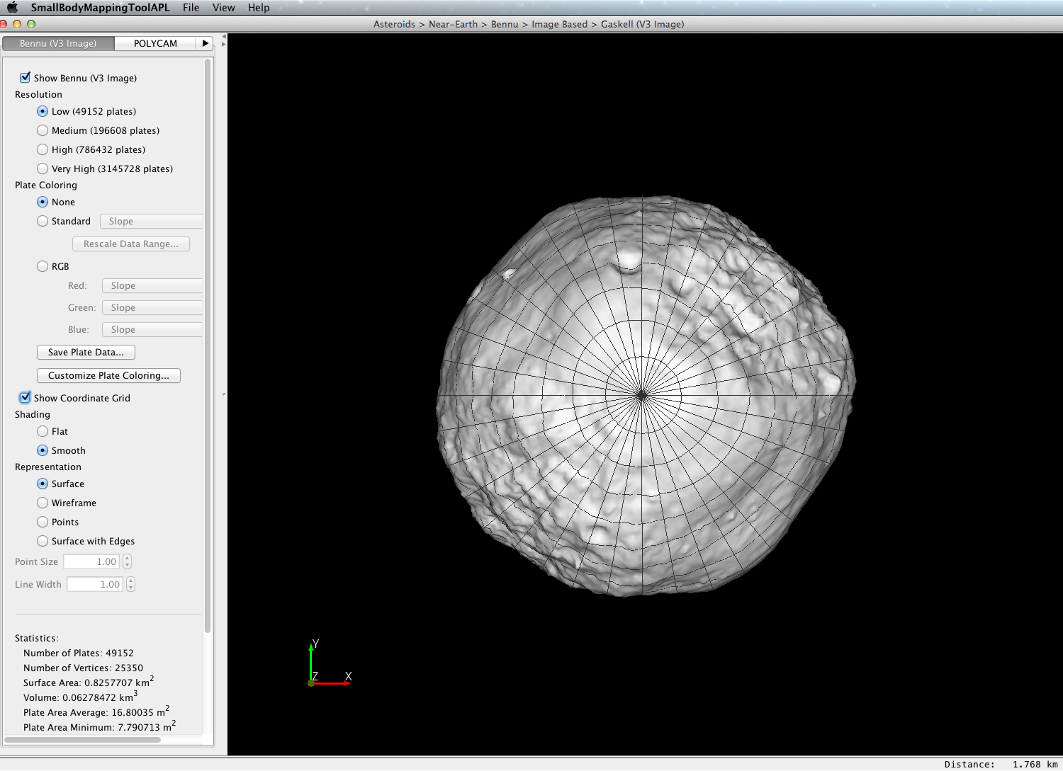
Control panel features: Show Coordinate Grid
Click here
Click “Show Coordinate Grid”

Slide 19
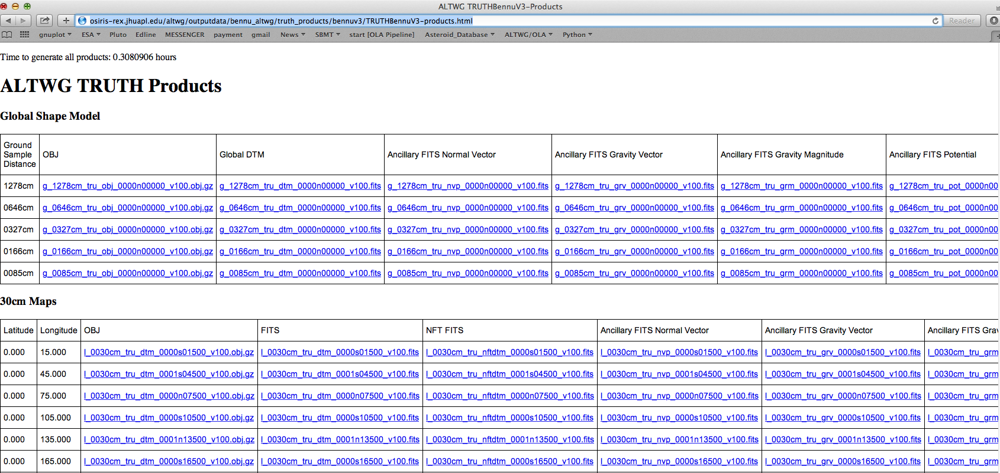
Add ancillary data
Find some ancillary data. Go to:
http://osiris-rex.jhuapl.edu/altwg/outputdata/bennu_altwg/truth_products/bennuv3/TRUTHBennuV3-products.html
Click here

Slide 20
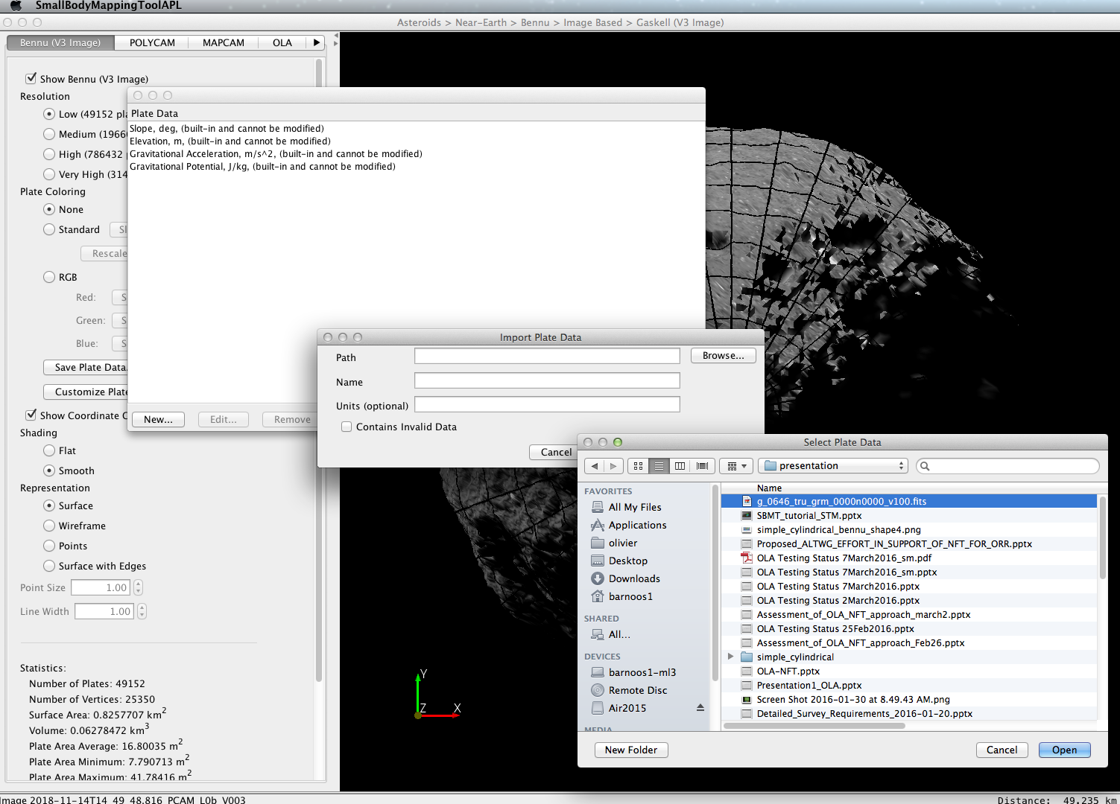
Add ancillary data
Click “Customize Plate coloring”
Navigate to ancillary data by clicking browse
Click here

Slide 21
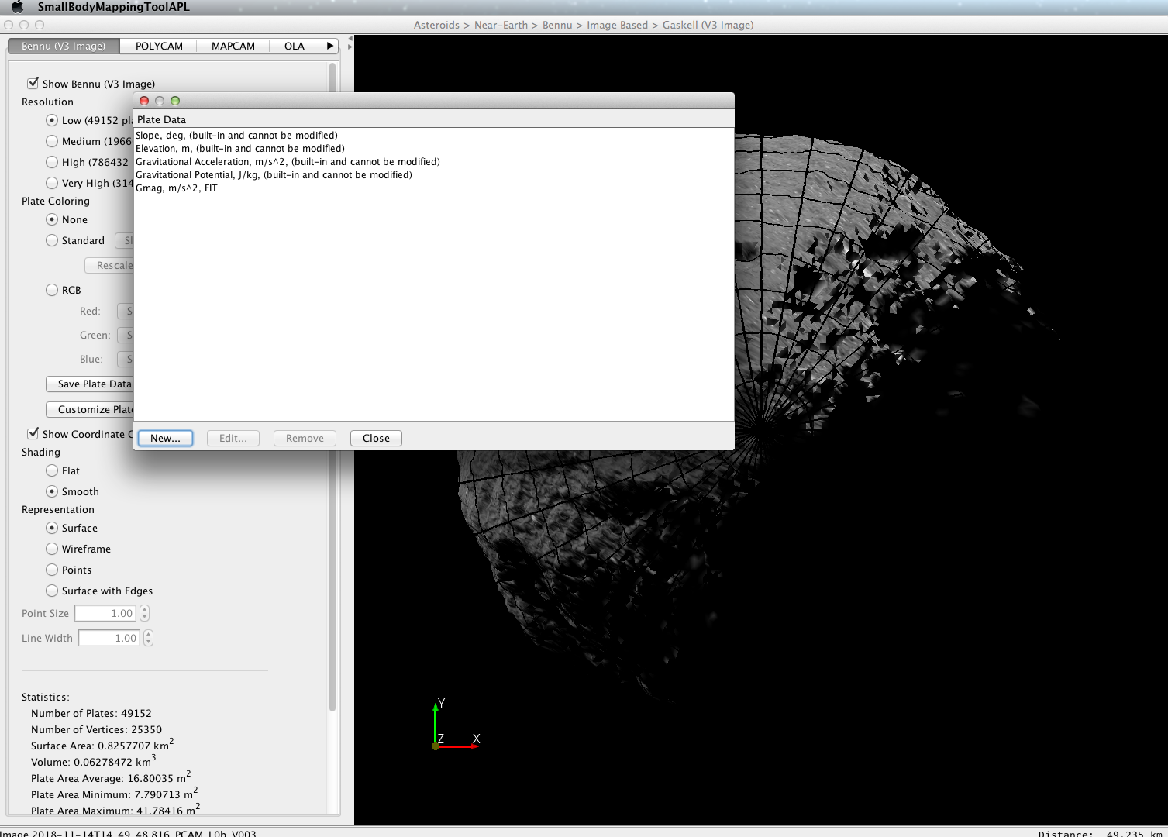
Add ancillary data
Click “Customize Plate coloring”
Navigate to ancillary data by clicking browse
Name the data whatever you want, and add units if desired
Click close
You have now added an new layer in Plate Coloring ->Standard
Click here

Slide 22
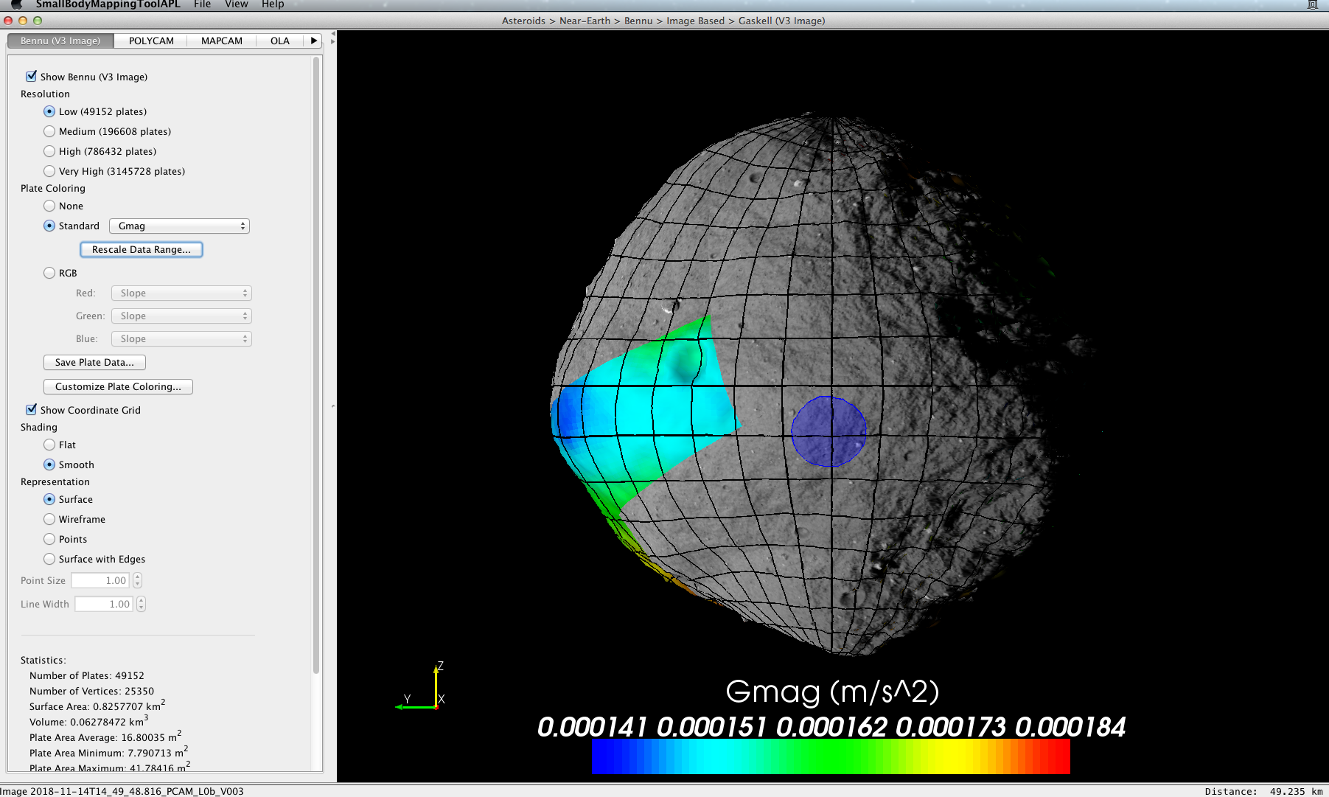
Add ancillary data
Click on Plate coloring standard toggle.
Choose the new layer you added: Gmag

Slide 23
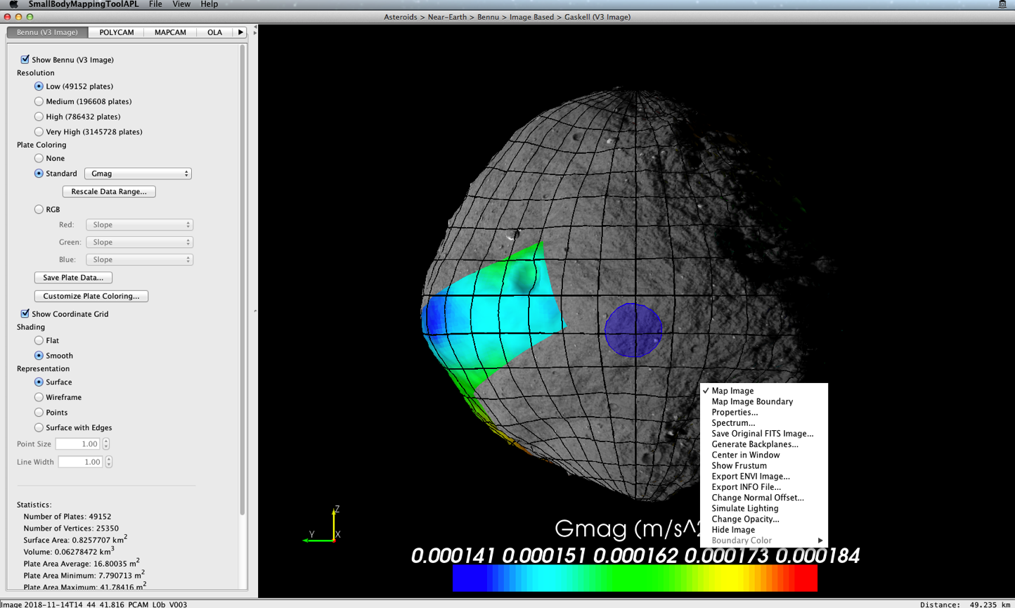
Transparent images
Right click on image
Choose Change Opacity

Slide 24
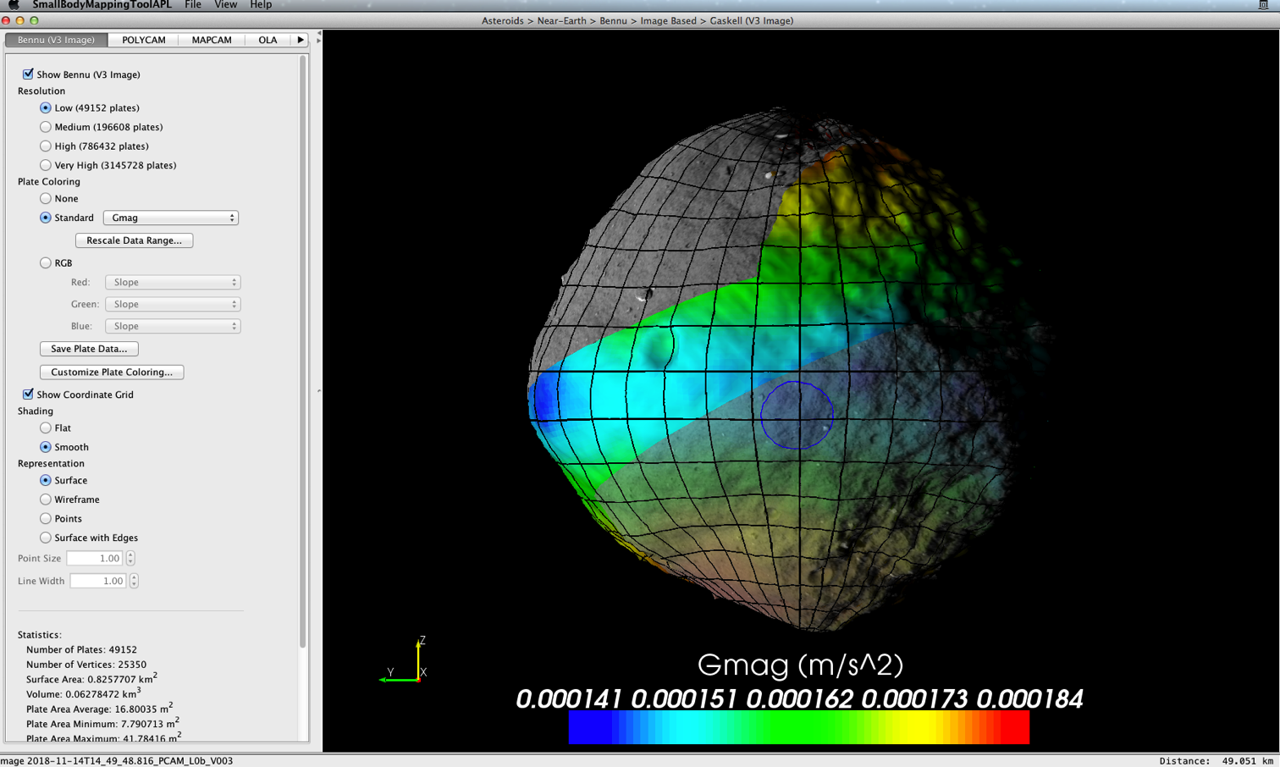
Transparent images
Right click on image
Choose Change Opacity

Slide 25
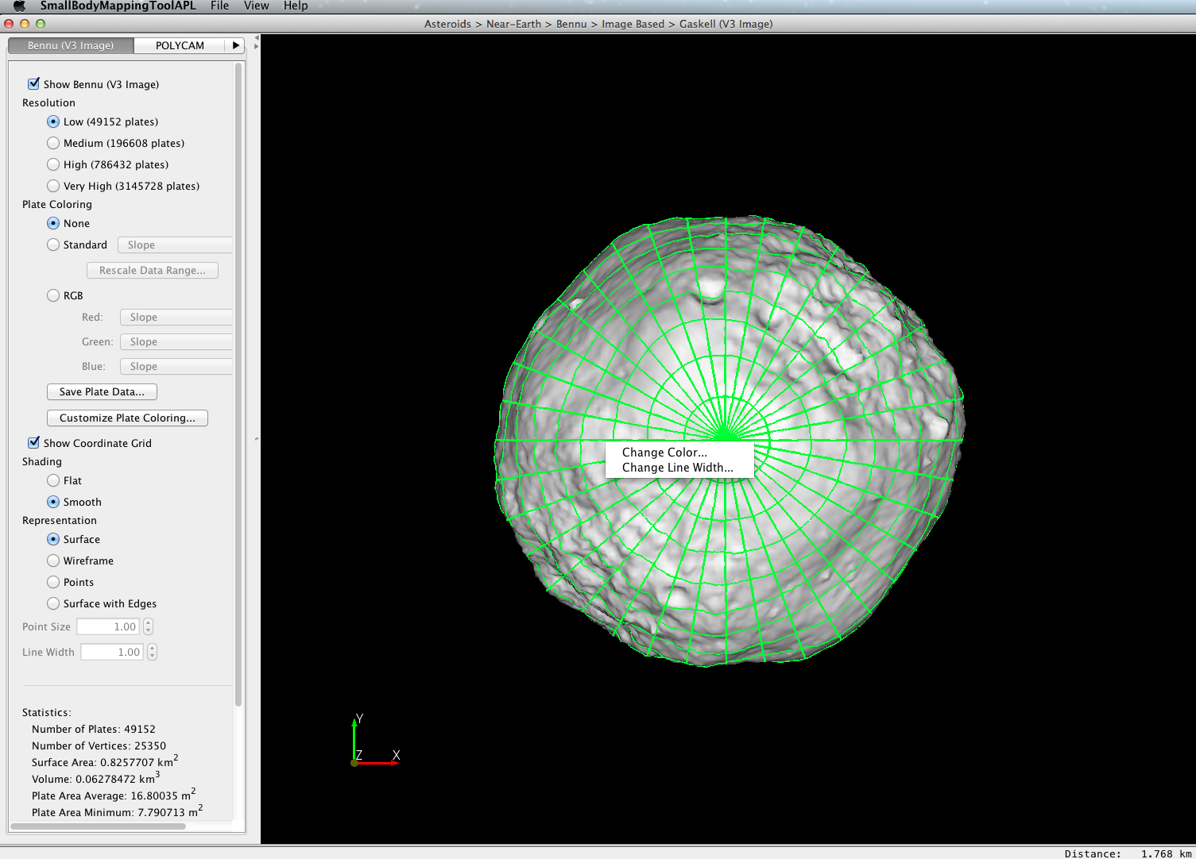
Renderer panel: change color of coordinate grid
Context
Menu
Right click on any part of the coordinate grid. A context menu will appear on the renderer where you clicked.
Click on the Change Color… option and select a new color.

Slide 26
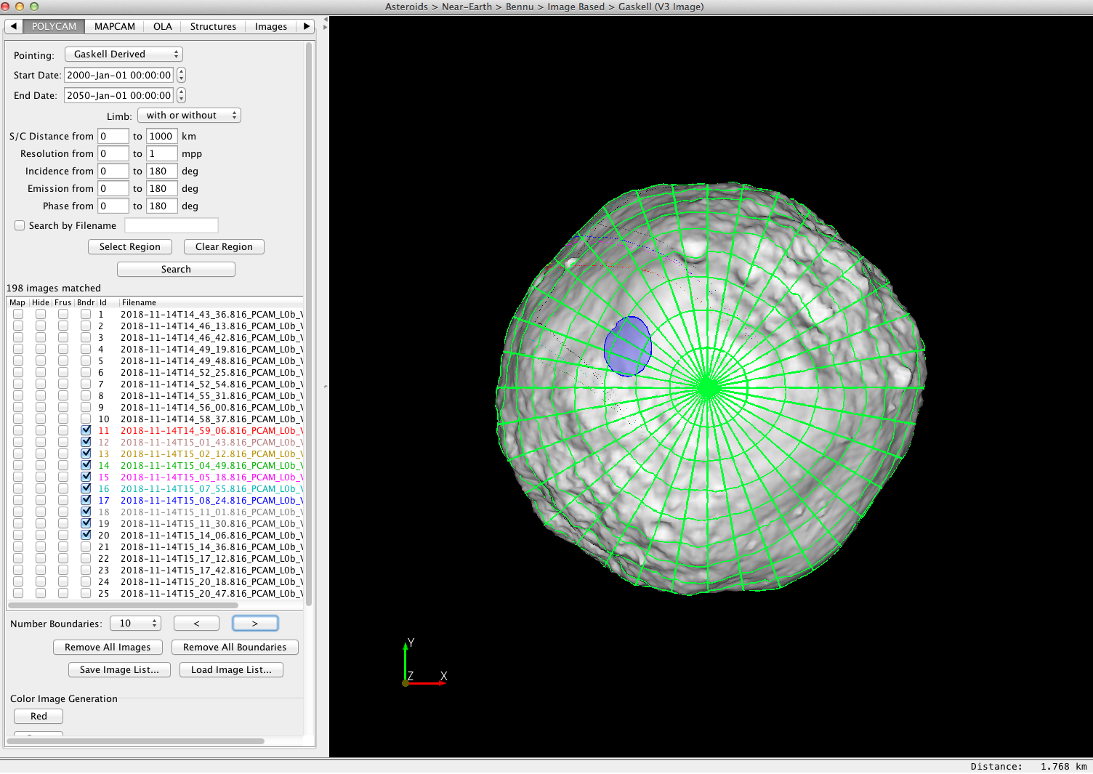
Polycam Image Search
Switch to the POLYCAM tab. This tab is used for searching and displaying POLYCAM images.
Click the Search region to perform a search using the default search options.
Click on select region, draw a search region, edit resolution and then click search to find images
A list of images will be returned sorted by date.
Boundaries of images will appear if images are smaller than object.

Slide 27
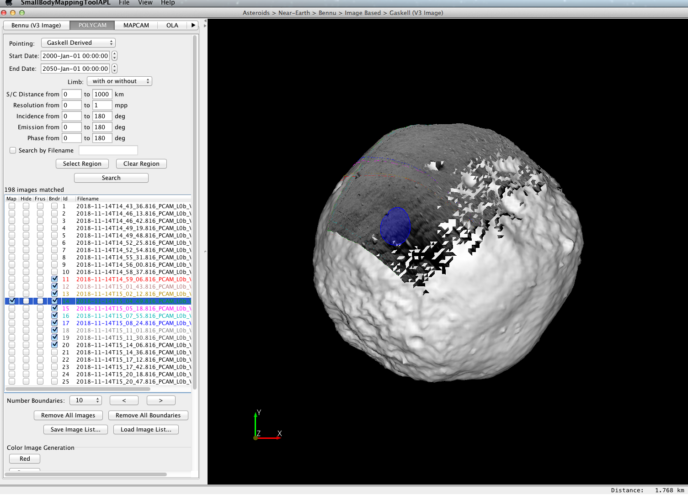
Map Image in Returned List
By default the boundaries of the first 10 matched images are shown in red in the renderer. If none or seen, it is because most images exceed size of observed object. You can see more boundaries by changing the boundary number or clicking the forward arrow. To map the image to the shape model, right click on the image and click “Map Image”
You can right click either on an item in the list or a boundary in the renderer view
Mapped Image

Slide 28
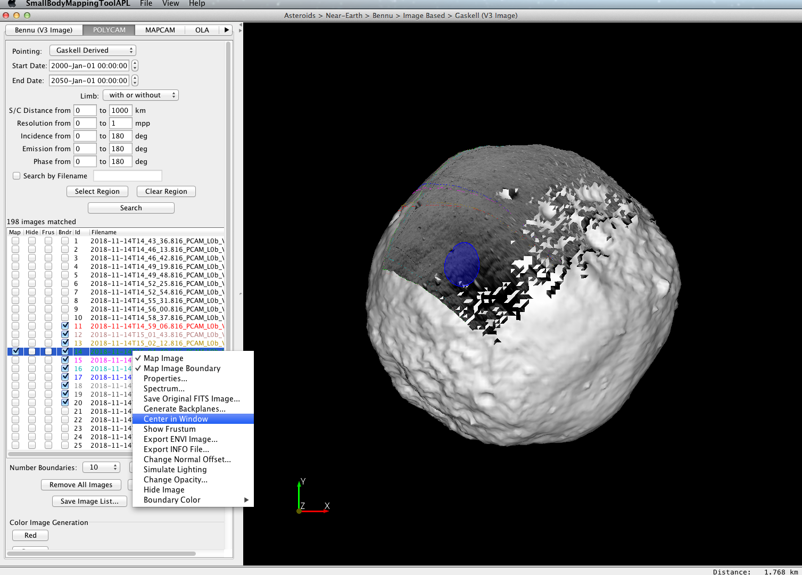
Center Image in Renderer View
You can center the image in the renderer view which reorients the shape model to mimic how the spacecraft viewed the shape model when it acquired the image.
Right click on an image and click “Center in Window”

Slide 29
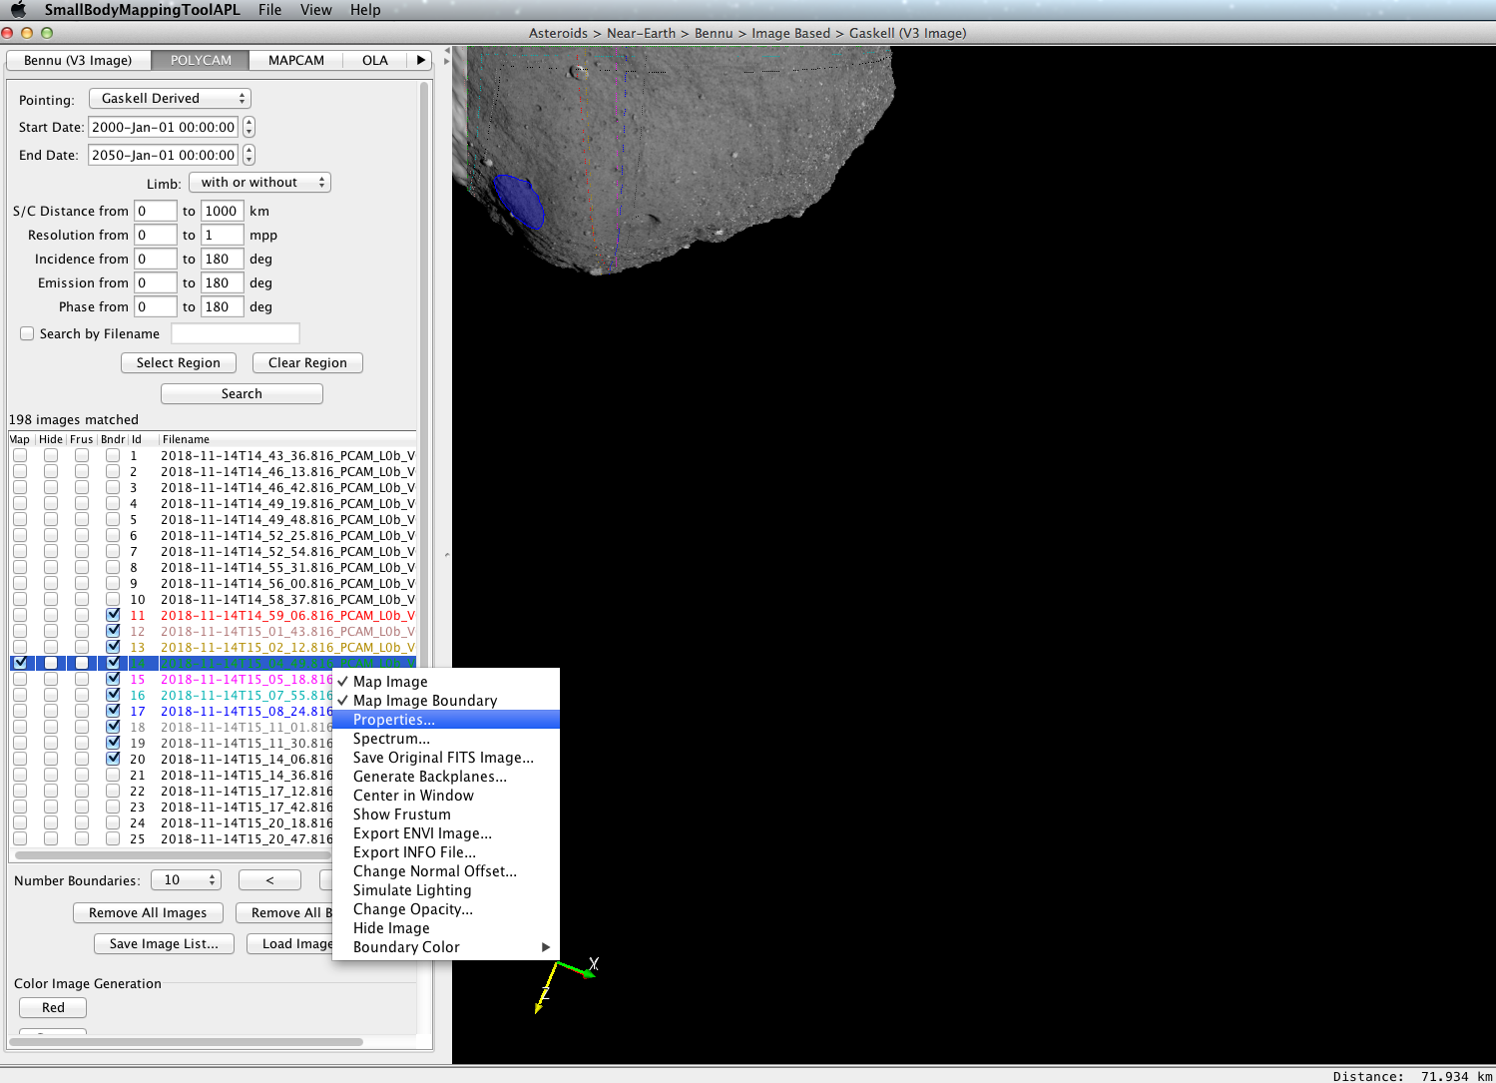
View asteroid as seen by camera
You can center the image in the renderer view which reorients the shape model to mimic how the spacecraft viewed the shape model when it acquired the image.
Right click on an image and click “Center in Window”

Slide 30
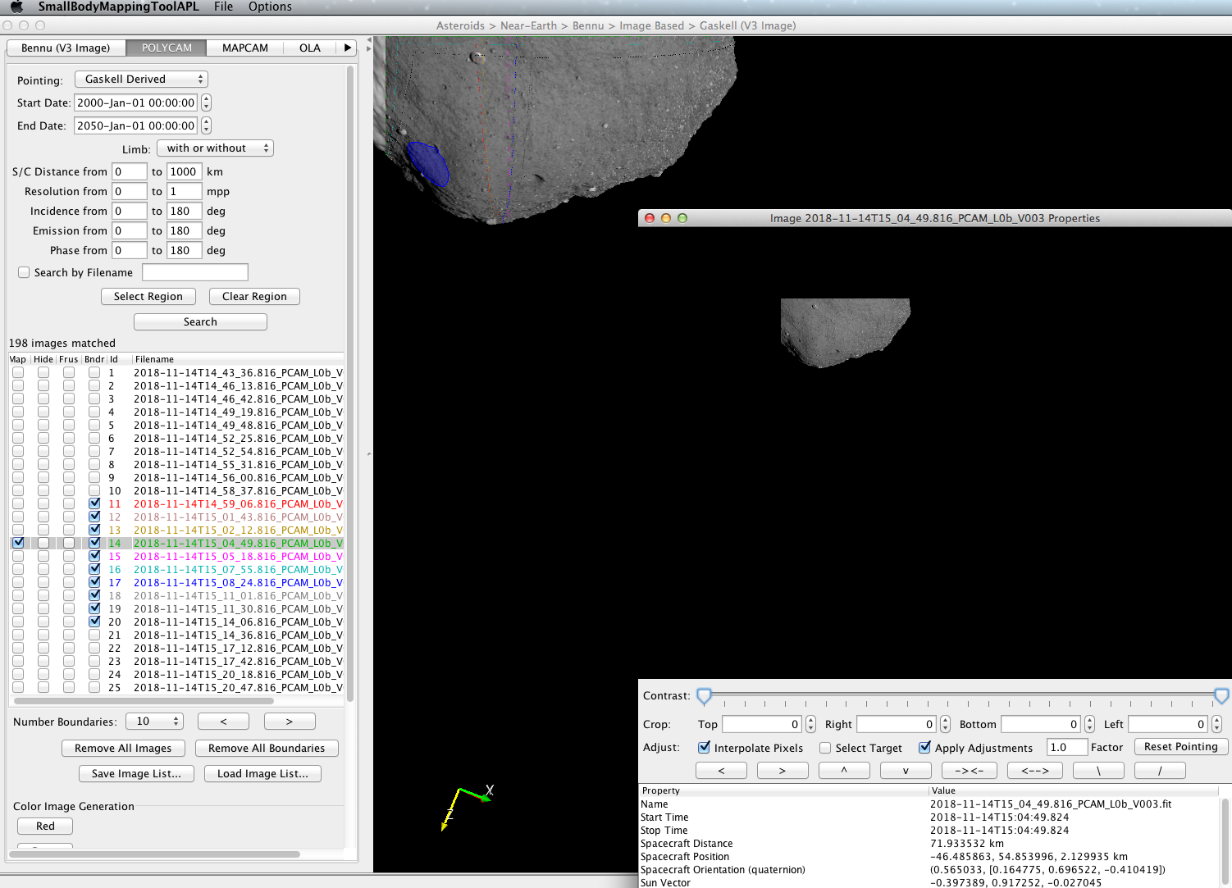
Check out properties of image and stretch
You can look at the original POLYCAM image and stretch it for visualization on the shape model by right clicking on the image highlighted in the list or the image boundary.
You can stretch the image, or physically move it if it doesn’t align properly. You can save adjustments you have made.

Slide 31
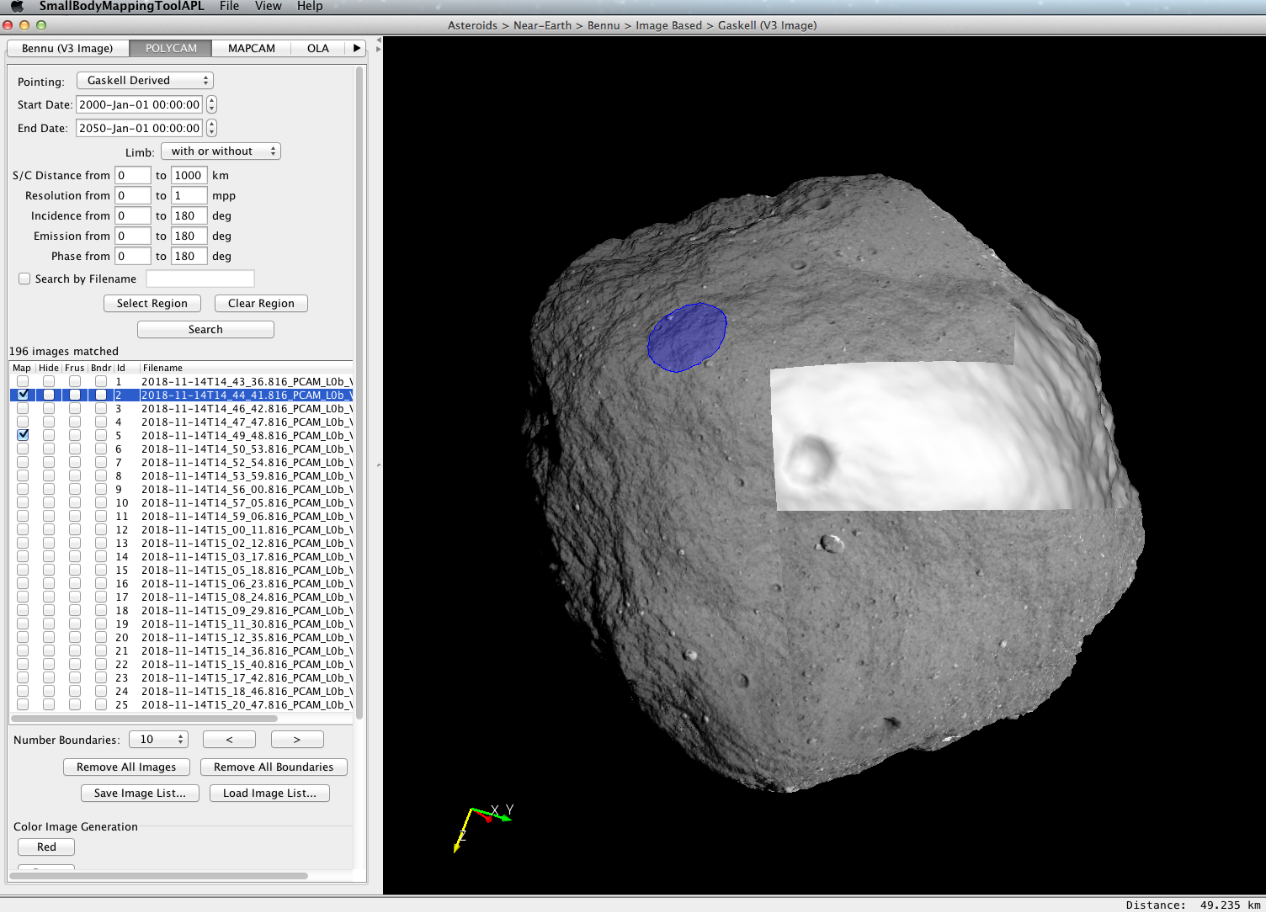
Quick mosaic
Map more than one image and play with stretch to get images to match up.
Currently can simply export result as a png which via fie>export to image.
As some point will be able to export a mosaic as a fits or Envi file.

Slide 32
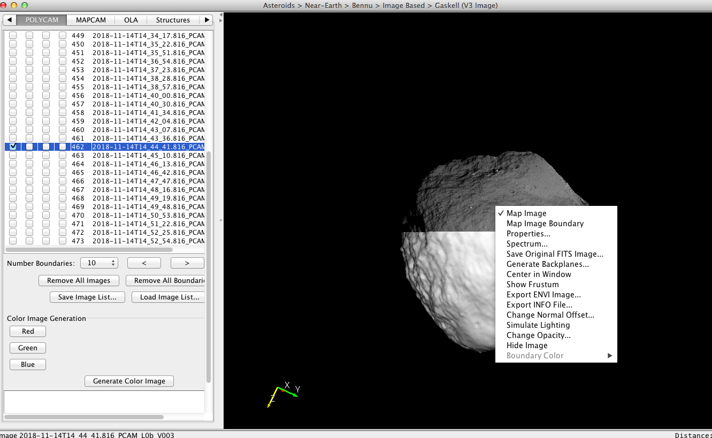
Downloading the original image or a backplane
To obtain the original image left click on image and then click on save original fits file
Also useful to download info file if you plan to manipulate file and want to bring what you created back into SBMT.
To obtain a “backplane” image with incidence, emission, phase, lat, long, radius, x, y, z, elevation, slope and so (from shape model currently selected) and left click on image in render or in list.
Image is output as a DDR.IMG file with PDS 3 label

Slide 33
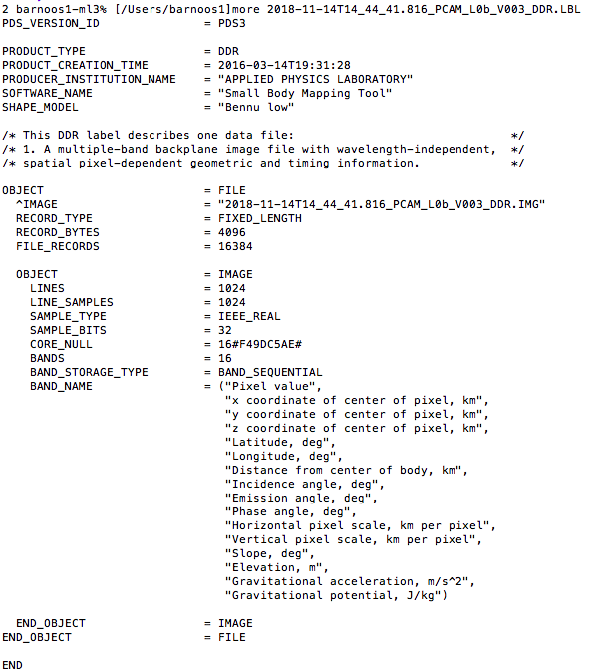
Downloading a back plane to an image
To obtain a “backplane” image with incidence, emission, phase, lat, long, radius, x, y, z, elevation, slope and so (from shape model currently selected) and left click on image in render or in list.
Image is output as a DDR.IMG file with PDS 3 label

Slide 34
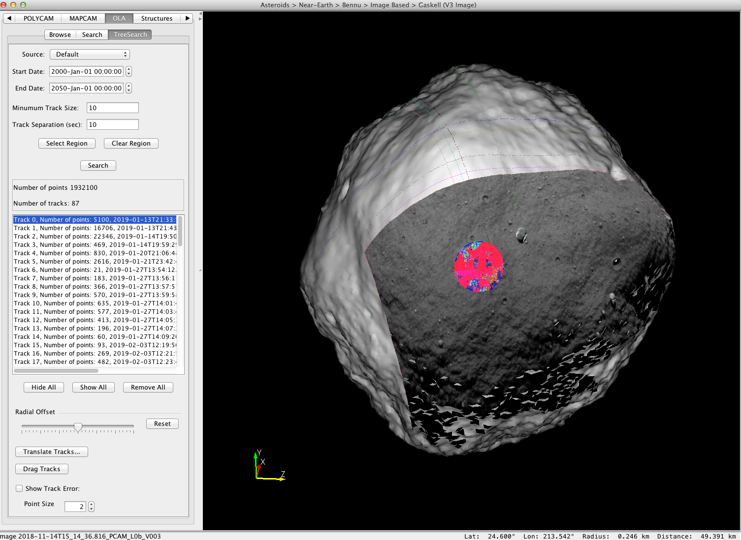
Find OLA data
Navigate to OLA -> TreeSearch Tab
Click on select region.
Choose a feature where you want OLA data. Then click search.
A little slow – but will provide all the data

Slide 35
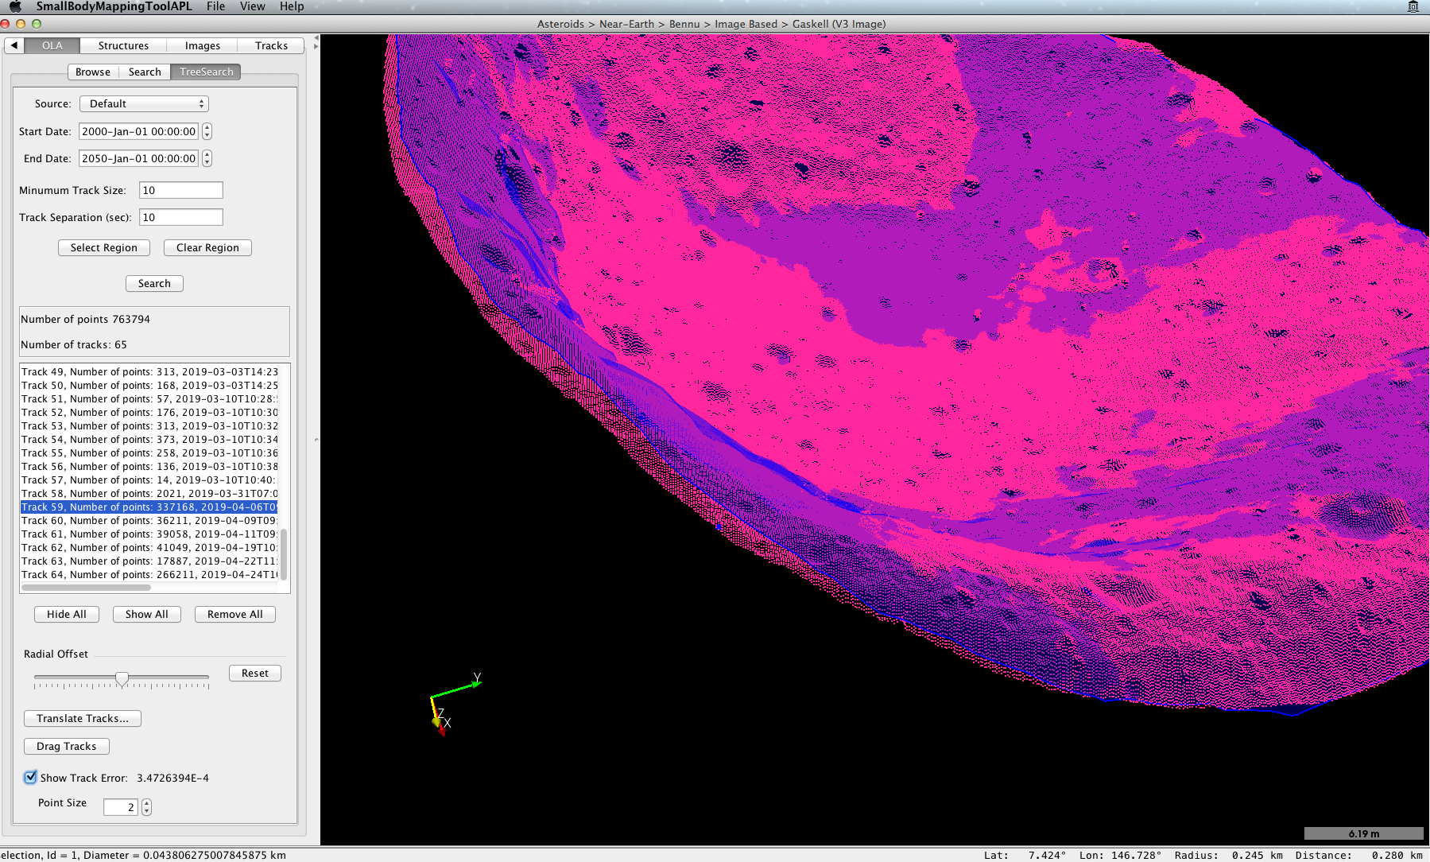
Find Individual OLA data
To identify a single OLA shot of interest
Disable LODs
Then click on point of interest
Status shows when data was collected
Highlights track of interest.

Slide 36
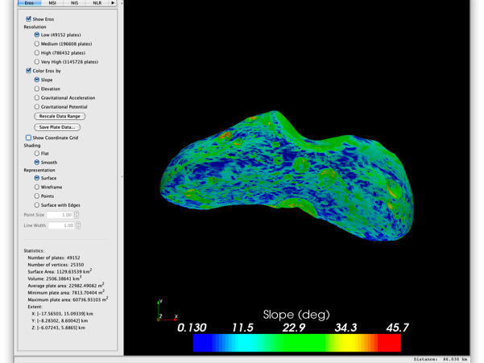
Control panel features:
Show Slope map of Eros
Click here
Check the “Color Eros by” checkbox. You will now see the asteroid colored by slope.

Slide 37
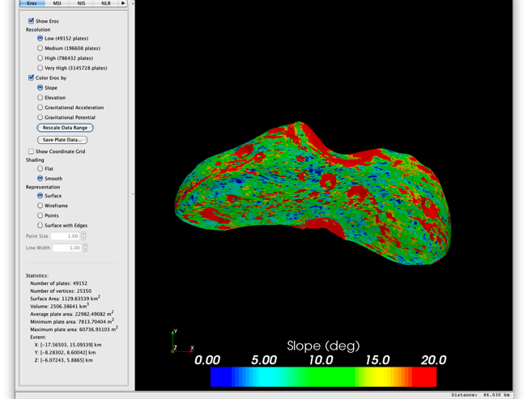
Control panel features:
Rescale range of slopes
The slope base map ranges from close to zero to about 45 degrees. We will now change the range from 0 to 20 degrees. Click the “Rescale Data Range” button. In the new window, Enter 0 for the minimum and 20 for the maximum. Then click OK.

Slide 38
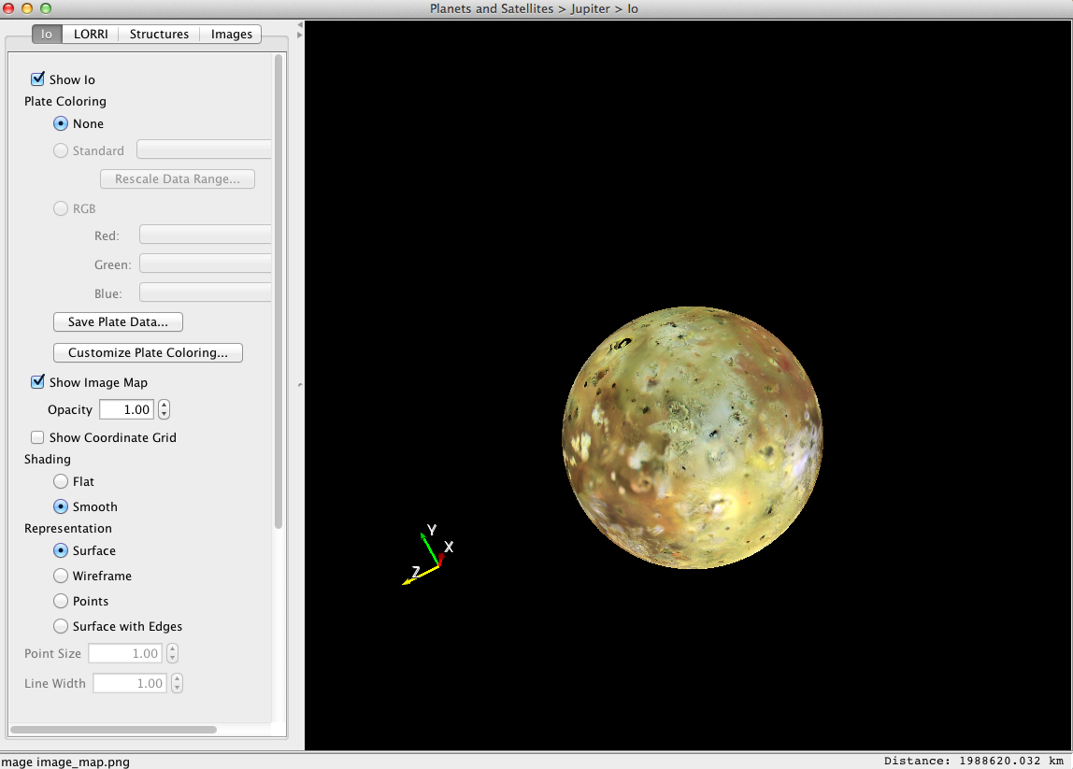
Show base map
If base maps are available, these can be shown by clicking the show map feature.
Simple cylindrical projected maps can also be injested via the Images tab or by assigning values to the shape model plates

Slide 39
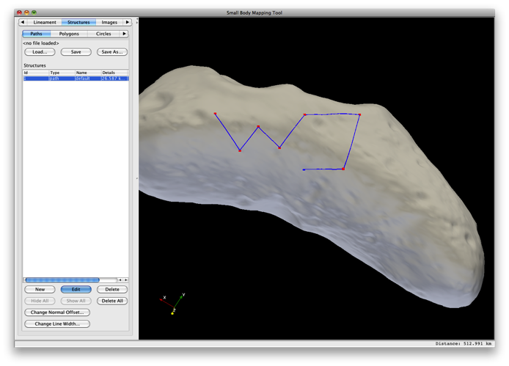
Draw Paths on Shape Model
Switch to Structures tab and within that tab click on the Paths tab.
Press New to begin drawing a Path.
You will be in Edit mode in which the shape model is frozen in the renderer and you will not be able to rotate, zoom and pan.
In the renderer view click on the shape model to specify the vertices of the Path.
When finished drawing the Path, press the Edit button to return to normal navigation mode.

Slide 40
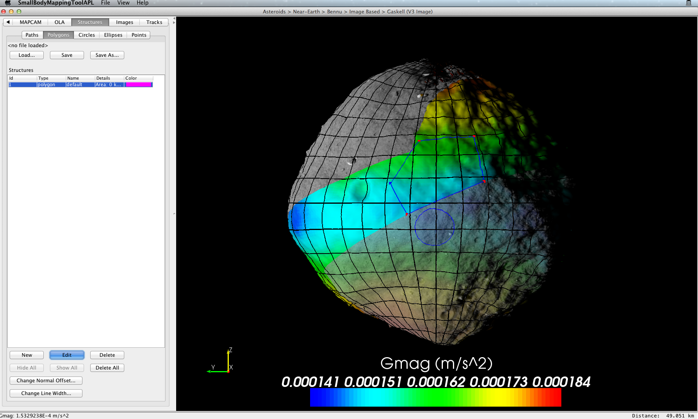
Draw Polygons on Shape Model
Switch to Structures tab and within that tab click on the Polygons tab.
Press New to begin drawing a polygon.
You will not be in Edit mode in which the shape model is frozen in the renderer and you will not be able to rotate, zoom and pan.
In the renderer view click on the shape model to specify the vertices of the polygon.
When finished drawing the polygon, press the Edit button to return to normal navigation mode.

Slide 41
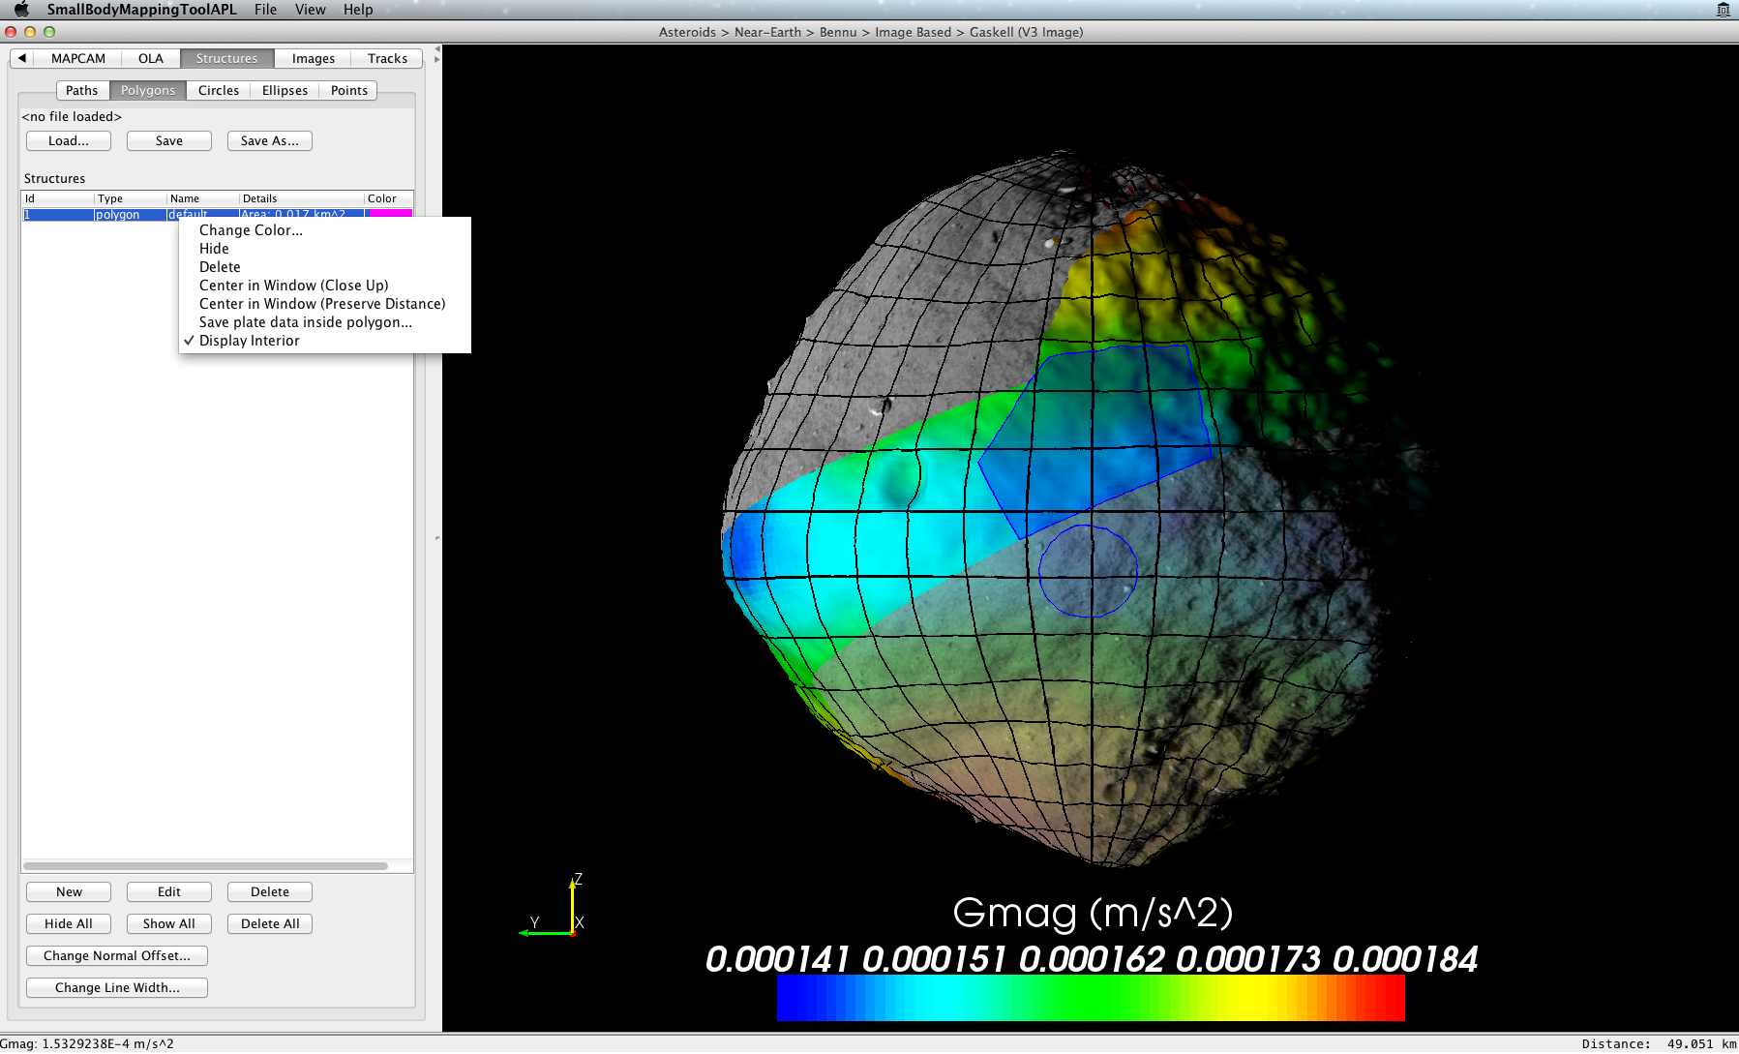
Draw Polygons on Shape Model
To determine the area in the polygon, right click on polygon in control panel, and click on display interior.
If you want to save the information on the facets in the polygon (including the ancillary data you have added) use save plate data.

Slide 42
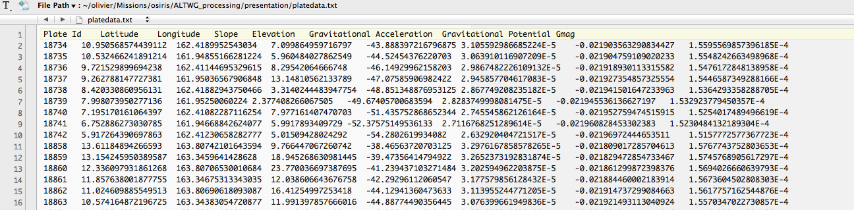
Draw Polygons on Shape Model
If you want to save the information on the facets in the polygon (including the ancillary data you have added) use save plate data.

Slide 43
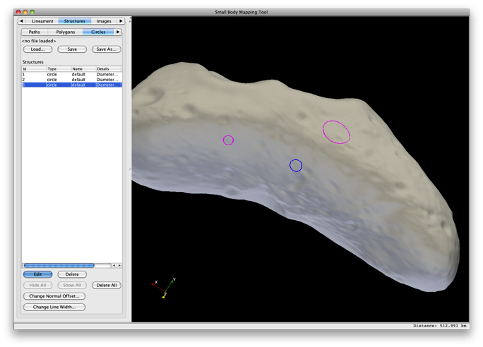
Draw Circles on Shape Model
Switch to Structures tab and within that tab click on the Circles tab.
Press Edit to begin drawing circles.
In the renderer view click on the shape model 3 times on the perimeter of the circle. After clicking the third point, a circle will appear through the 3 points.
Click on another 3 locations to draw a second circle.
When finished drawing circles, press the Edit button again to return to normal navigation mode.

Slide 44
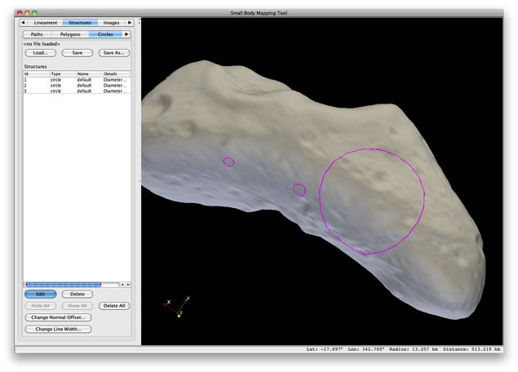
Change position and Size of Circle
Click on the Edit button to enable Edit mode.
Position the cursor over a circle. The cursor will change to a hand shape.
Drag the circle while holding down the left mouse button to move it to a new location
Drag the circle while holding down both the left mouse button and the control or shift button to change its size.

Slide 45
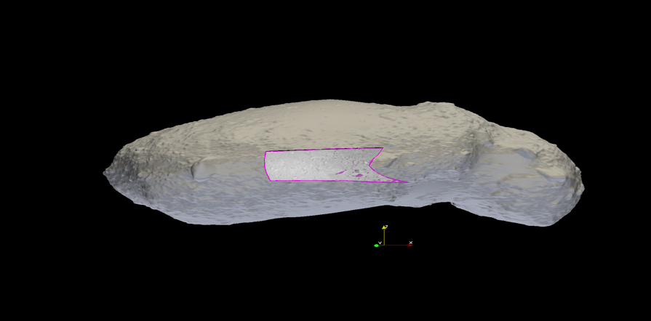
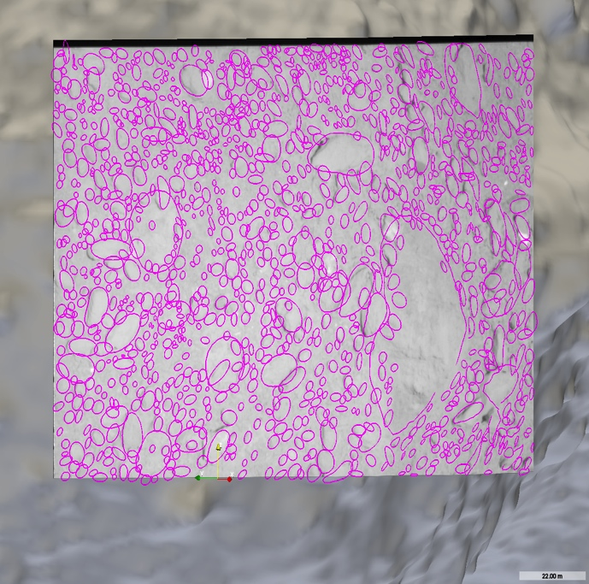
Draw Ellipses on Shape Model
Switch to Structures tab and within that tab click on the Ellipses tab.
Press Edit to begin drawing ellipses.
Click on the shape model 3 times, first along the semi-major axis, and then perpendicular along semi-minor axis. After clicking the third point, an ellipse will appear through the 3 points.
When finished drawing ellipses, press the Edit button again to return to normal navigation mode.
22.0m

Slide 46
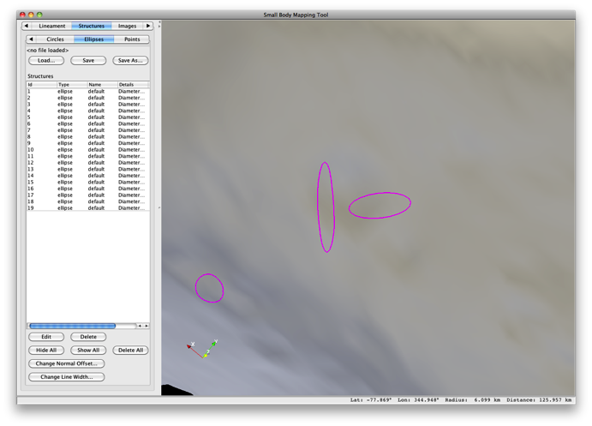
Change Flattening and Orientation of Ellipse
Click on the Edit button to enable Edit mode.
Position the cursor over an ellipse. The cursor will change to a hand shape.
To change the flattening of the ellipse (ratio of semi-minor to semi-major axis), drag the ellipse while holding down the left mouse button and the ‘z’ or ‘/’ (forward slash) key.
To change the orientation of the ellipse, drag the ellipse while holding down the left mouse button and the ‘x’ or ‘.’ (period) key.
The position and size of an ellipse can be changed in the same manner as circles.

Slide 47
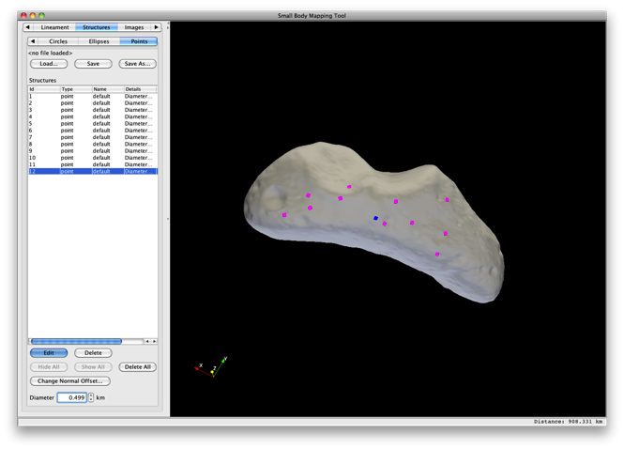
Draw Points on Shape Model
Switch to Structures tab and within that tab click on the Points tab.
Press Edit to begin drawing points.
Each time you click on the shape model with the left mouse button, a point will appear at that location.
When finished drawing points, press the Edit button again to return to normal navigation mode.

Slide 48
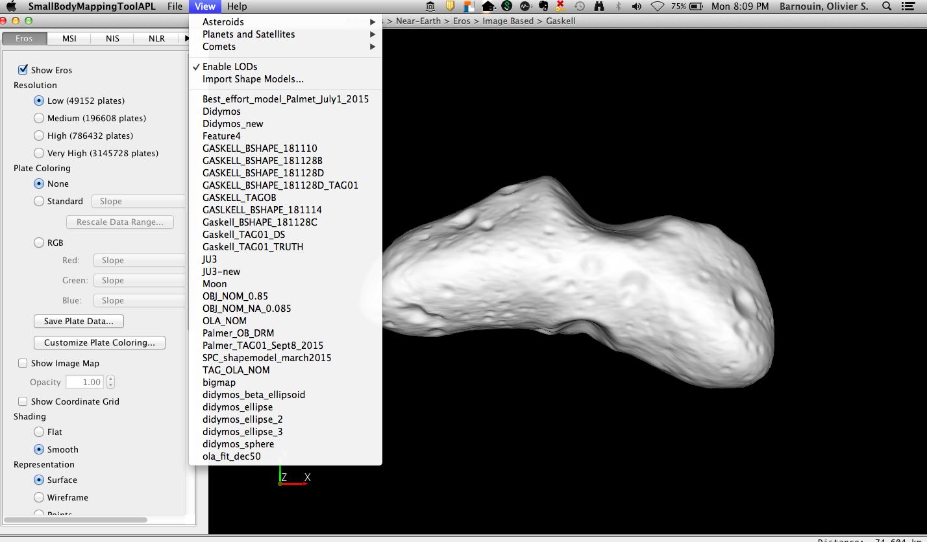
Importing a regional DTM
Two main ways to import a shape model into sbmt
Quick and dirty approach – you just made an obj and you want to take a look.
At command line run:
Runsbmt nameoffile.obj
If you want to add ancillary data, images and so on.
View>import shape model

Slide 49
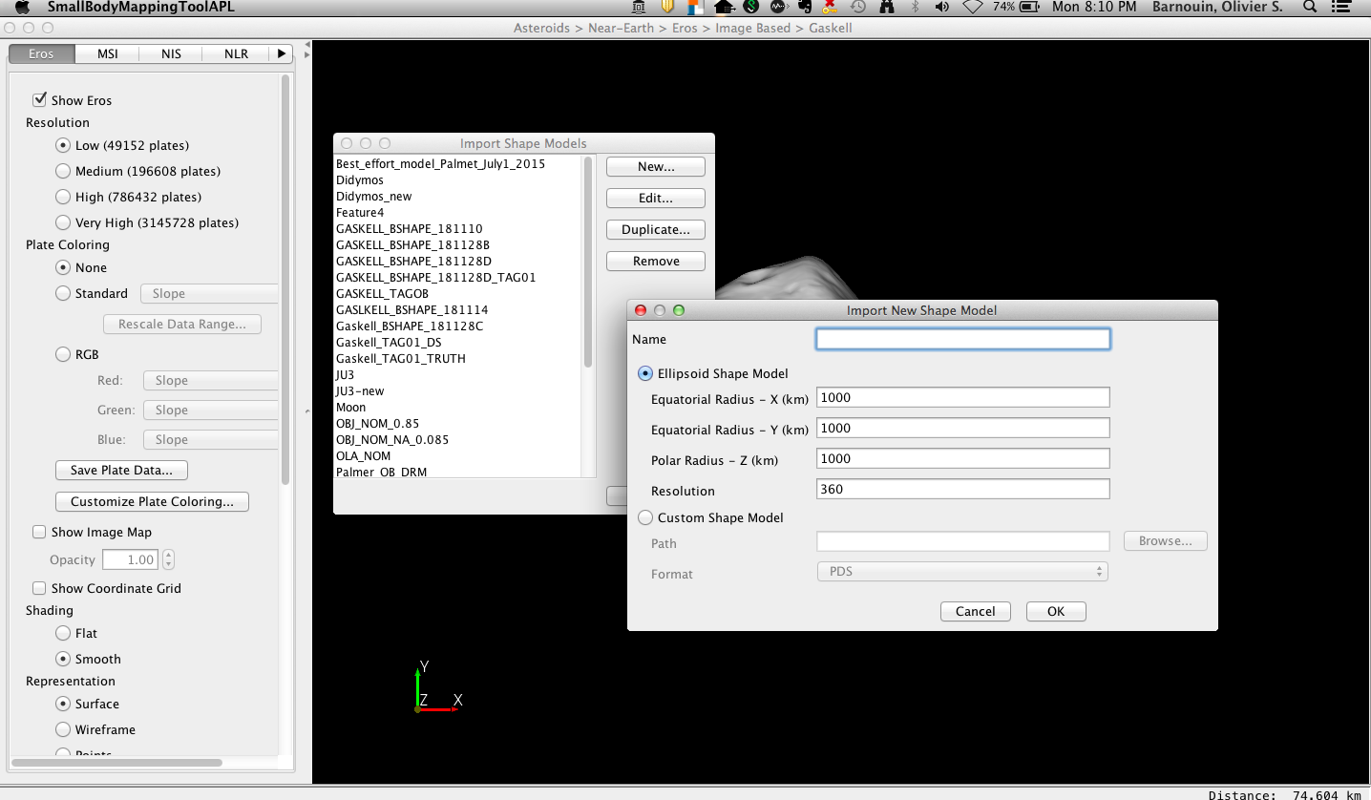
Importing a regional DTM
Click on New
Type in name of new shape model.
Choose new model type:
You have the option of generating an ellipsoid or adding a new shape model (OBJ, PLT – Gaskell plate format, or Vtk fomat)
Custom model: browse to model

Slide 50
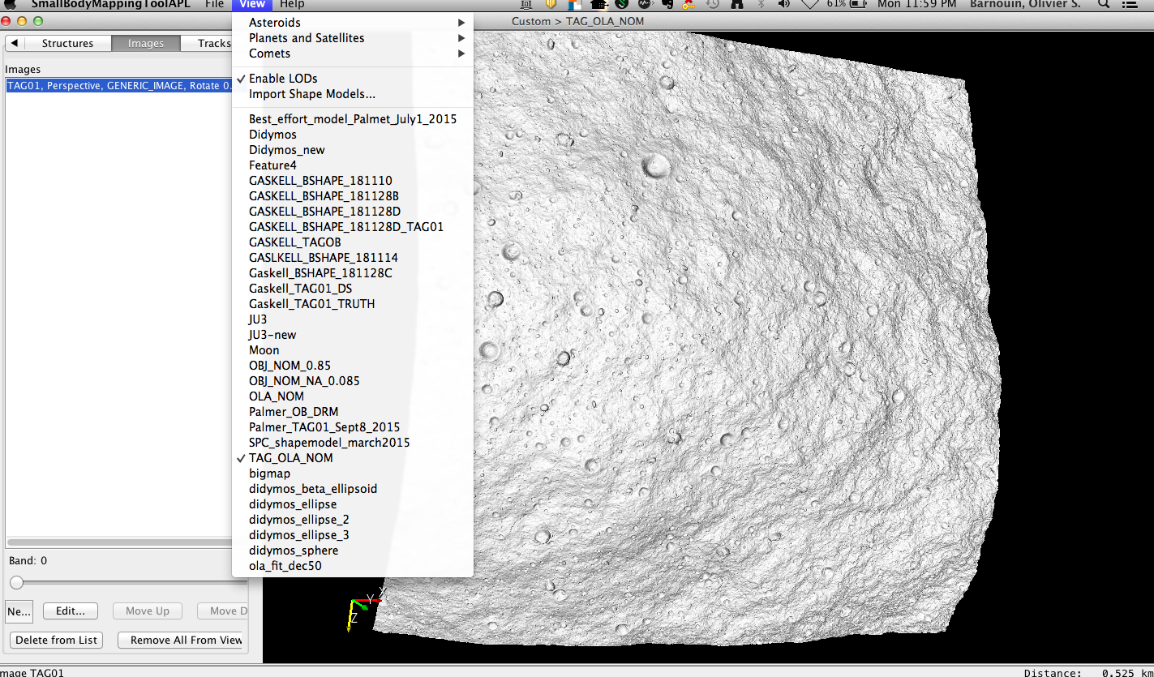
View Imported DTM
Click on View
Select from list of model you imported
Chose OLA DTM

Slide 51
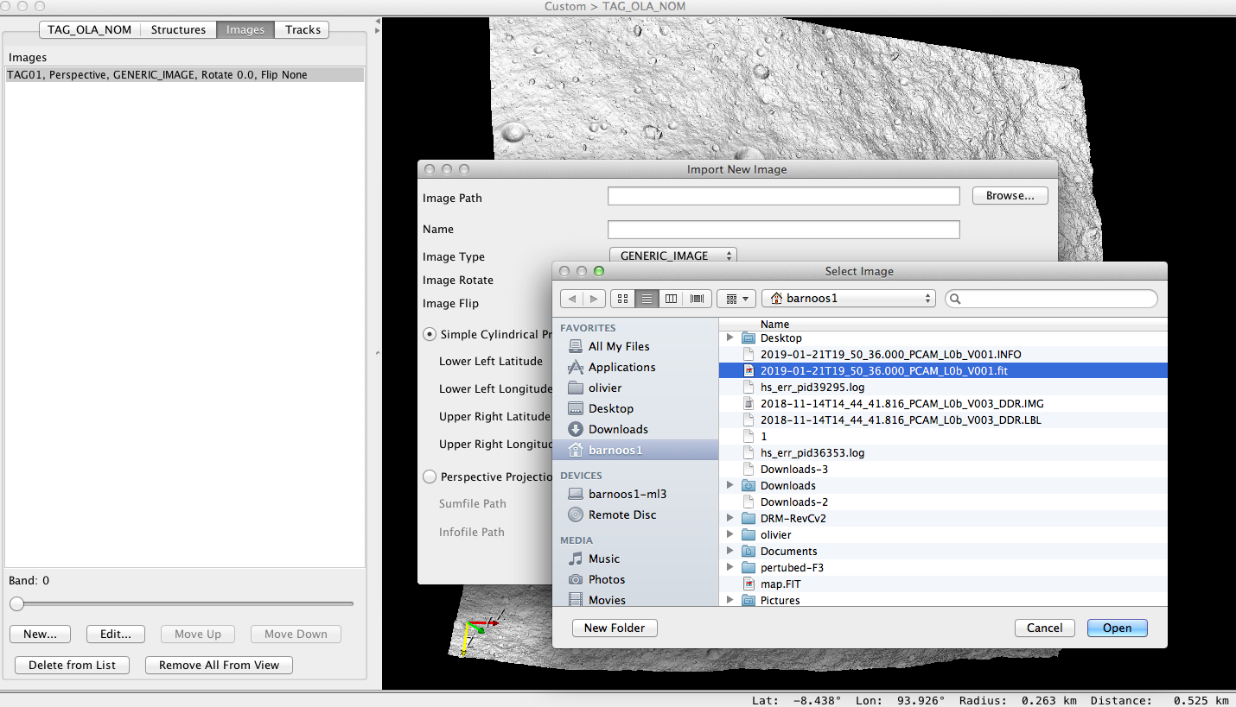
Overlay an Imported Image on Imported DTM
Click on Images
Click on New
Click on Browse and find image you would like to place over model
You may need to rotate and flip image depending on camera (not required for these Polycam images)
Can overlay image using simple cylindrical projection or sbmt infofile or gaskell sumfile. Infofiles can be generated once an image is saved from SBMT. They are also easy to compute.

Slide 52
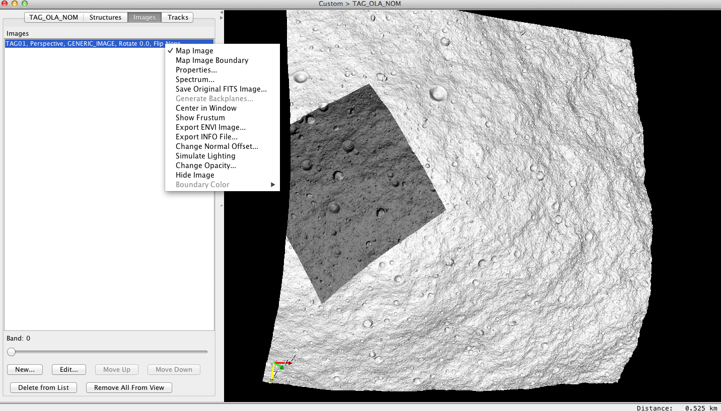
View Imported Image on Imported DTM
Left click on image that you imported
Click Map image

Slide 53
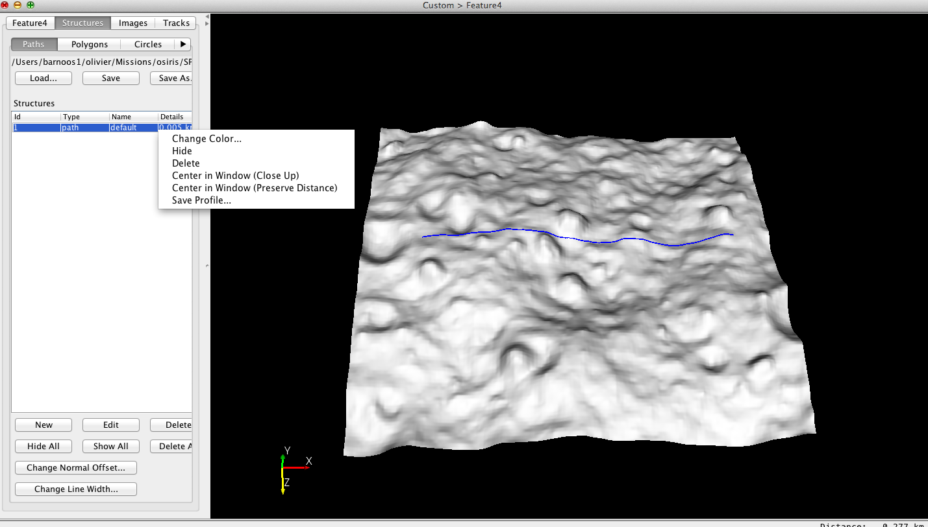
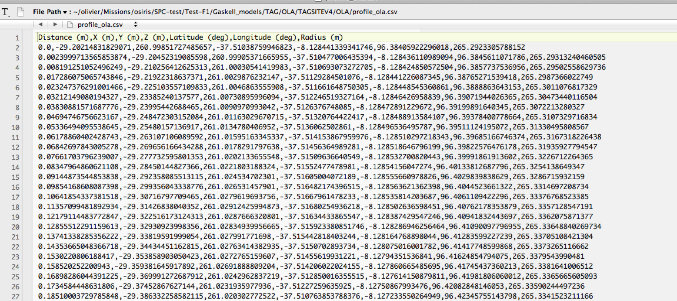
Drawing a profile across the asteroid
Switch to Structures tab and within that tab click on the Path tab.
Press Edit to begin drawing path. For profile use only two points.
Press Edit to get out of edit mode. Then right click on the path you just created and save profile. It will output all available data associated with shape model along path.

Slide 54
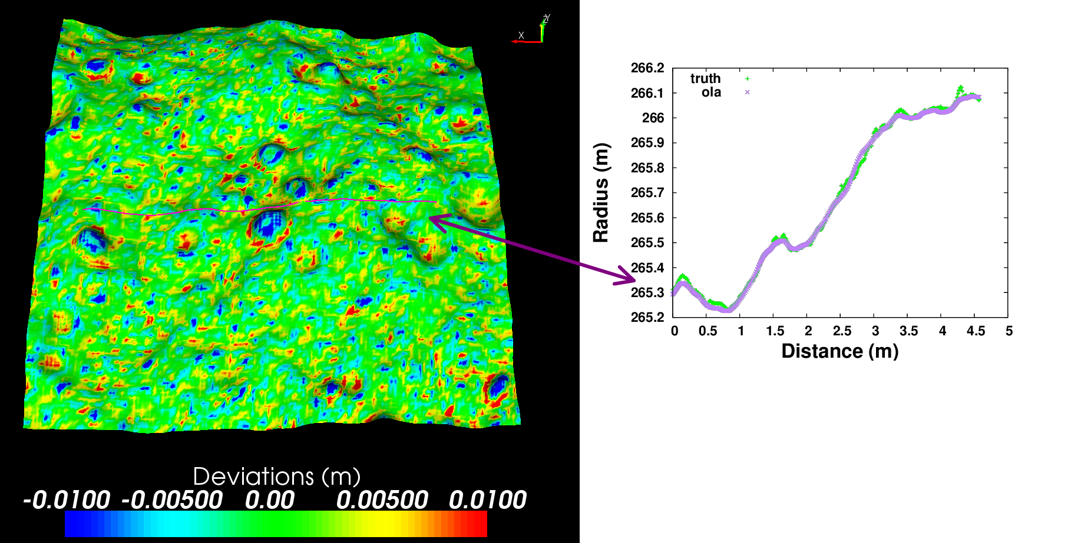
Drawing a profile across the asteroid
Import profile in your favorite plotting program (gnuplot output shown)
Difference between a truth DTM and a simulated OLA DTM

Slide 55

Changing preferences
Want a white background? Change the color of the axes shown or remove it altogether?
Changing lighting of model?

Slide 56
Changing preferences
Want a white background? Change the color of the axes shown or remove it altogether?
Changing lighting of model?

Slide 57

Changing preferences
Want a white background? Change the color of the axes shown or remove it altogether?
Changing lighting of model?
Changed
Lighting model
Add/Remove color axes

Slide 58

Changing preferences
Want a white background? Change the color of the axes shown or remove it altogether?
Changing lighting of model?
Change background color

