Slide 1
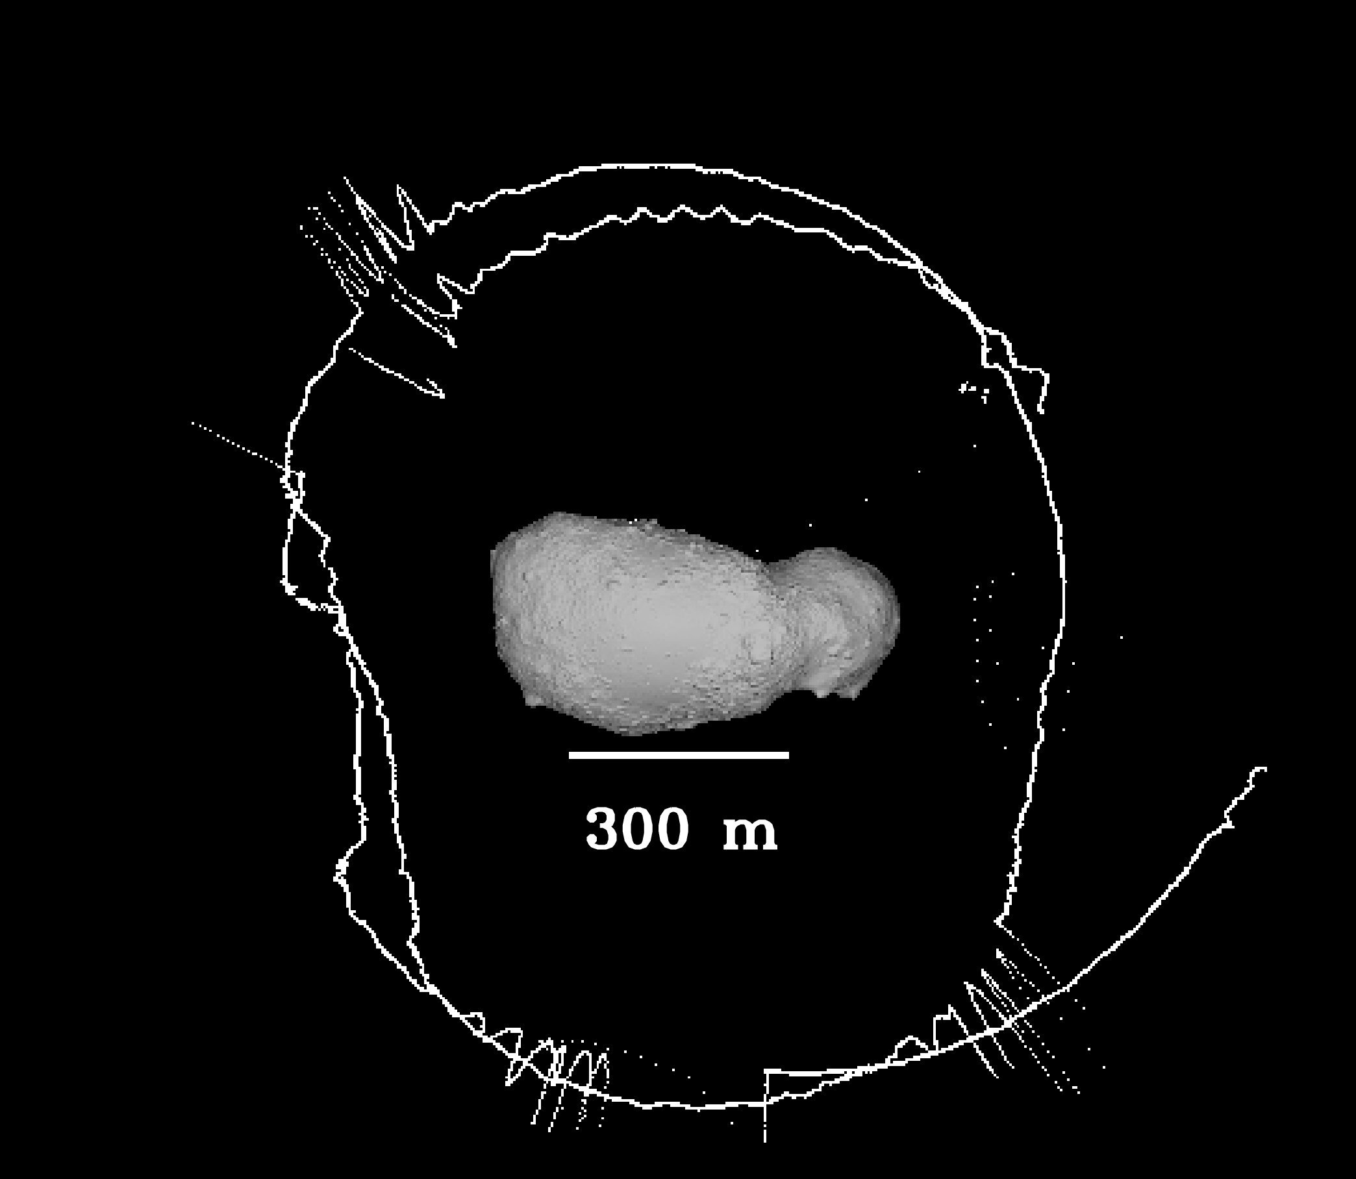
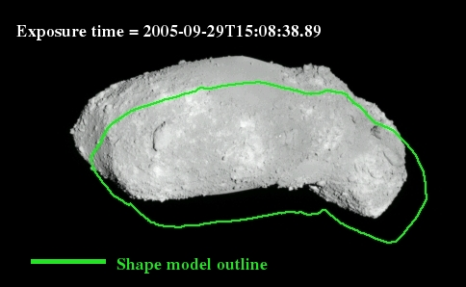
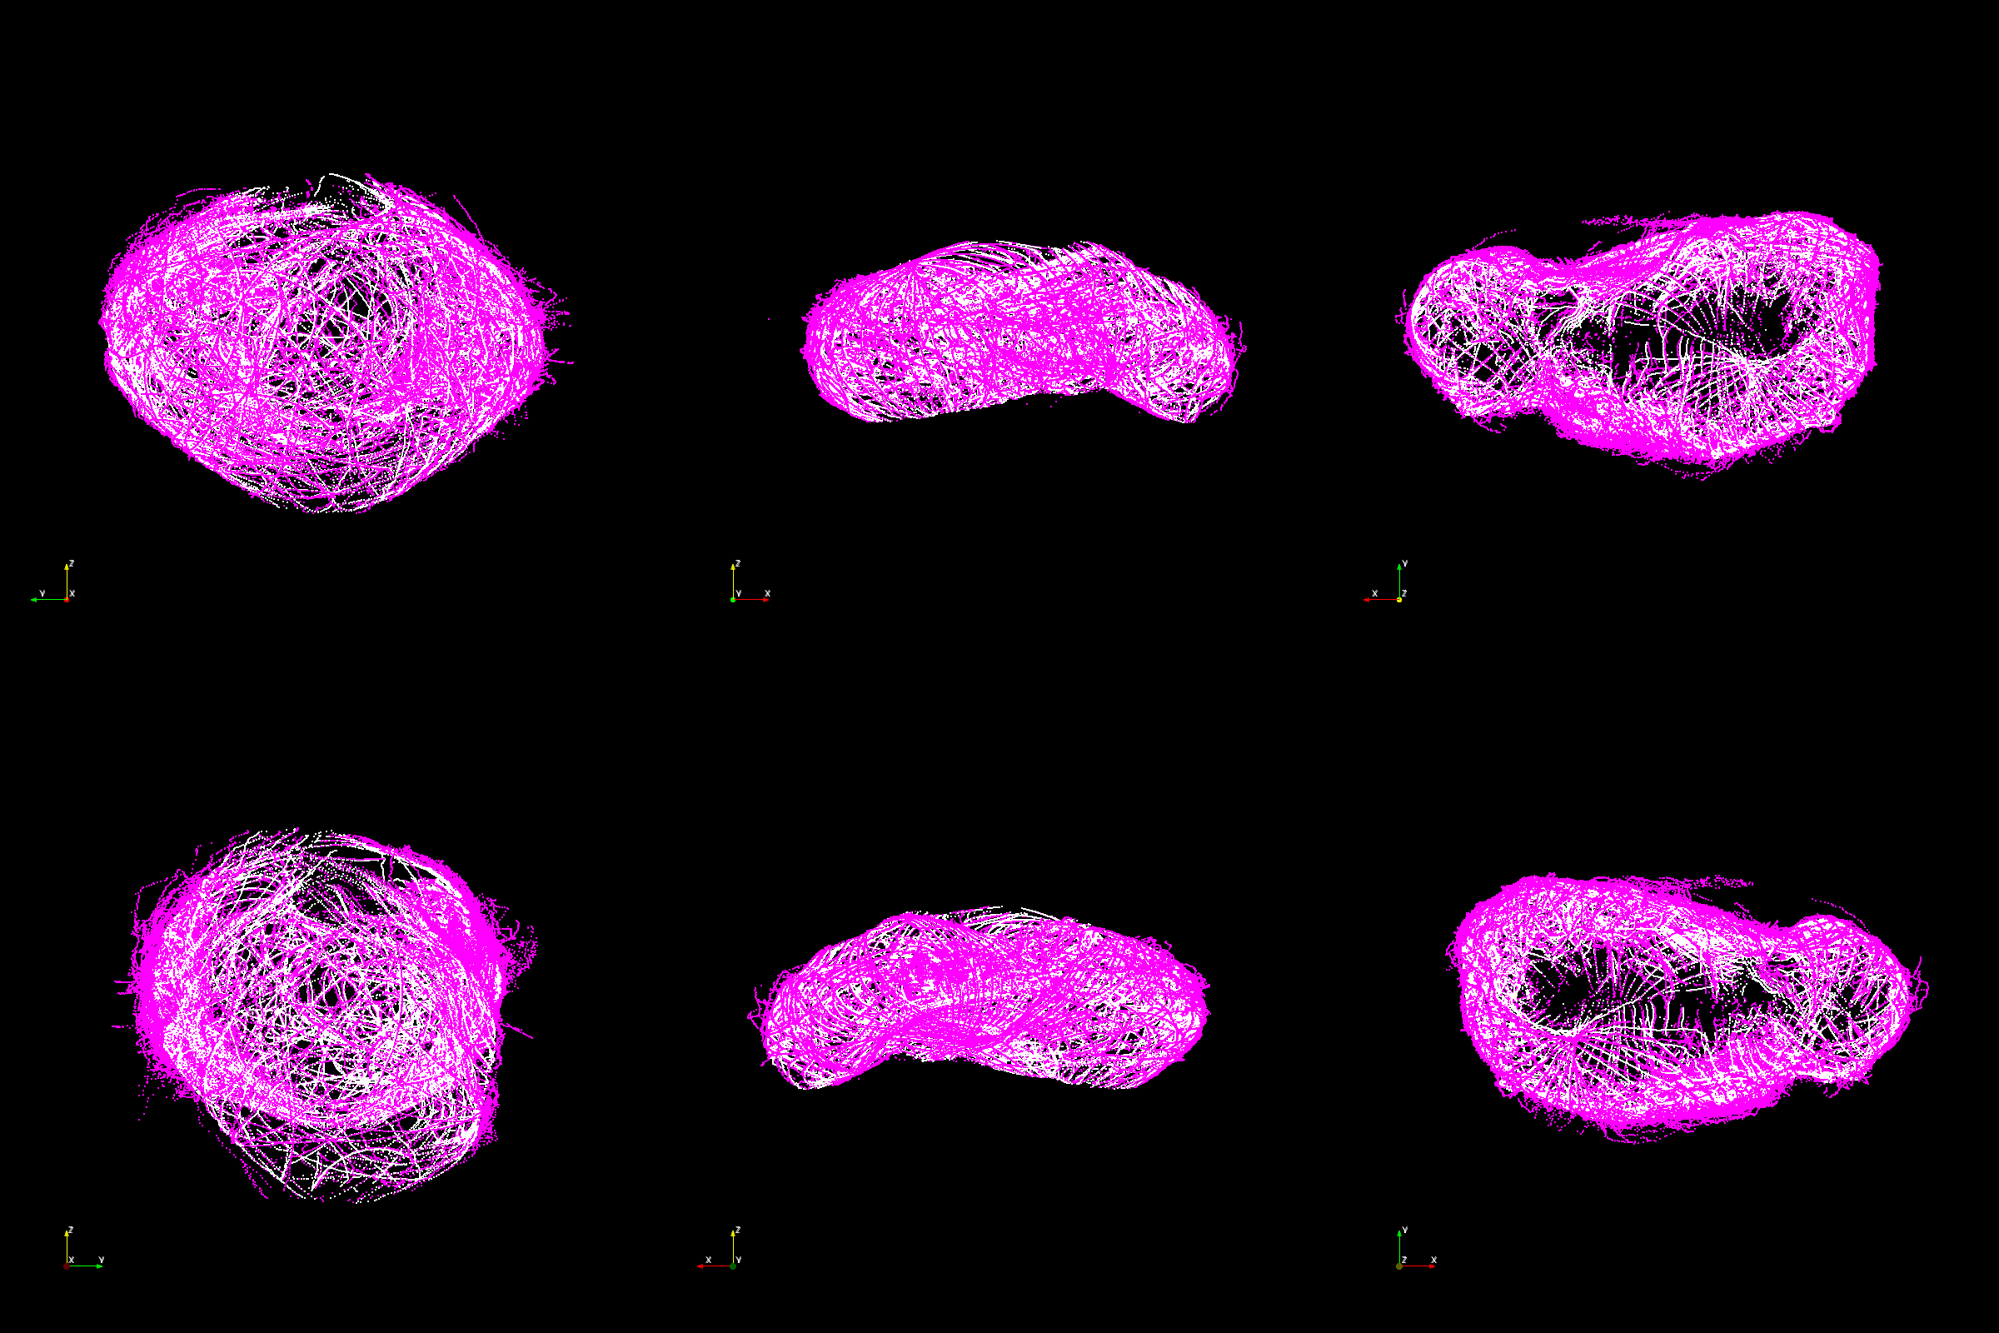
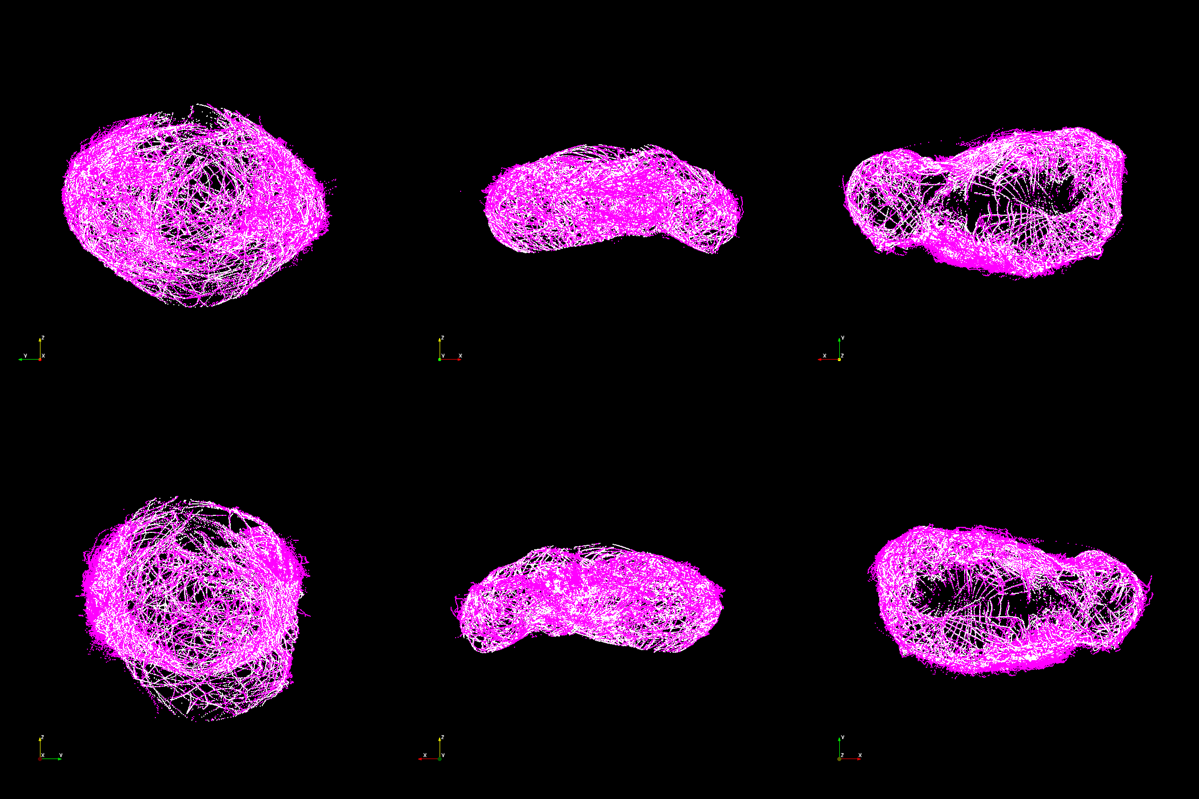
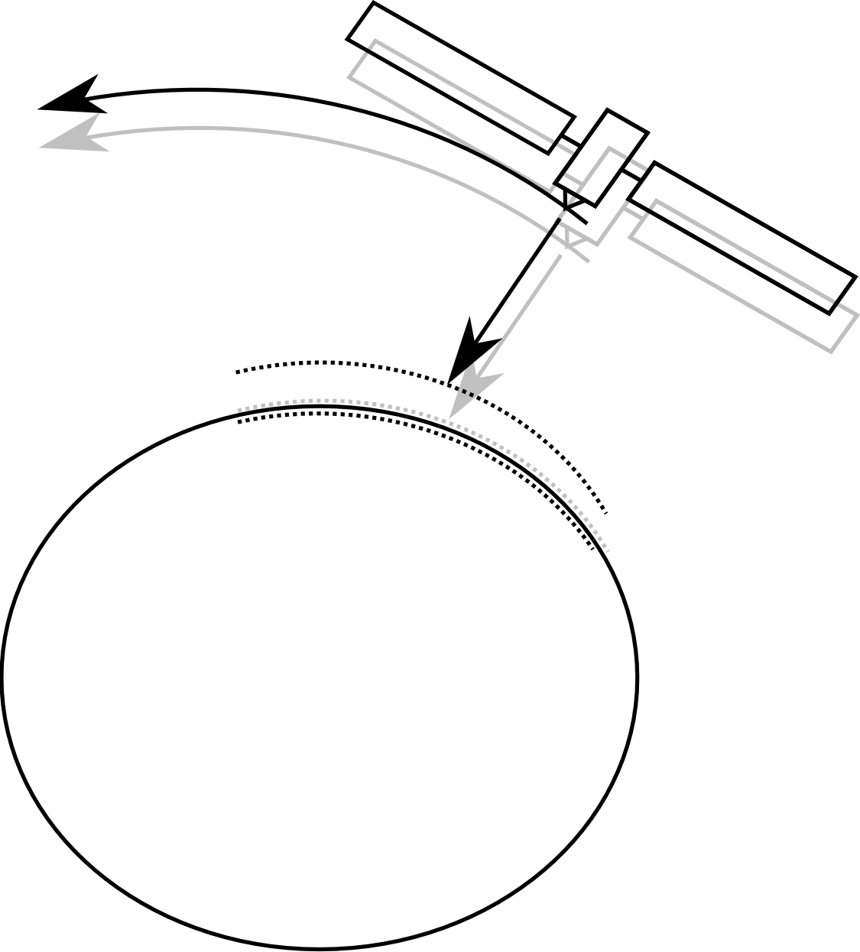
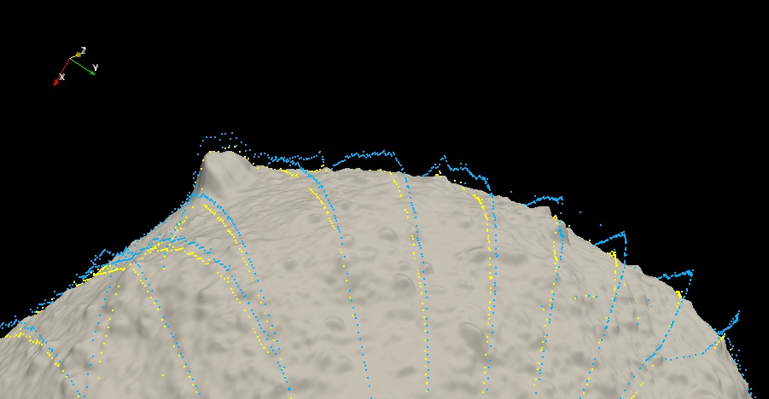
Improved Estimation of the Hayabusa Spacecraft Trajectory and Lidar Tracks
Eliezer G. Kahn¹, Olivier S. Barnouin¹, Carolyn M. Ernst¹
¹The Johns Hopkins University Applied Physics Laboratory, 11100 Johns Hopkins Road, Laurel, MD, USA
Introduction
The original trajectory of the Hayabusa spacecraft while hovering over the asteroid 25143 Itokawa possessed several inaccuracies that made it initially very difficult to reconstruct the topography of the asteroid from the lidar range measurements and estimate the gravitational forces of the asteroid (Figure 1) [1,2]. An important improvement to the estimate of the spacecraft trajectory was calculated by fitting parabolas to the Hayabusa spacecraft housekeeping data collected at two minute intervals [2]. These data simultaneously provided the centroid location of the asteroid in the field of view of the wide-angle camera aboard the Hayabusa spacecraft, and a range measurement to the asteroid surface [3].
Despite significant improvements in the results, errors of several meters in the measured range persisted. In this poster we describe an algorithm to further improve this first estimate of the spacecraft trajectory as well as the location of the lidar tracks by making use of a high resolution Itokawa shape model [4,5] to shift the trajectory so that the lidar points better match Itokawa’s topography.
Results
We validated the algorithm with 3 approaches:
Mean Range Error: We computed the error in range using the estimated spacecraft trajectory averaged over all lidar points both before and after running the algorithm. We obtained a reduction of about 4 meters, from about 7.4 to 3.5 meters.
Comparison with Stereo-Photoclinometry: We obtained highly accurate positions of the Hayabusa spacecraft at several hundred points in time during Hayabusa’s orbit of Itokawa derived using Stereo-Photoclinometry, or SPC, [4] that provides accurate estimates of spacecraft positions during the process of creating the Itokawa shape model using the images acquired by Hayabusa’s AMICA imager. We computed the error between the corrected positions of the spacecraft as computed by this algorithm and the positions of the spacecraft as computed by SPC and found a modest reduction in error by about one meter, from about 11 to 10 meters.
Visual Inspection: Figures 2-4 below show comparisons of the lidar data before and after the algorithm was run. Notice that the improved lidar data is closer to the asteroid than the original lidar.
In addition, the lidar data has been archived on the PDS [7] and is available for download.
Figure 1: These images illustrate the inaccuracies of the original spacecraft trajectory. The left image shows the very noisy nature of the trajectory prior to smoothing with parabolas. The right image shows how the outline of Itokawa as would be computed using the original trajectory differs from the outline of Itokawa as seen on the acquired AMICA image.
Method
The following algorithm was performed to improve the lidar data:
Divide data into small overlapping tracks of several hundred points each
For each track:
Let S be set of lidar points (the source points)
Let T be intersection points on asteroid along line joining spacecraft position and lidar point (the target points)
Perform a point matching scheme (described next) to find the optimal translation that best matches the source points S to the target points T.
Apply optimal translation to original lidar points S as well as to the spacecraft positions to produce the improved data.
Take average of overlapping tracks
Spacecraft
trajectory
Figure 3: The original lidar data for the month of November, 2005 where magenta is the lidar data and white is the intersect of the lidar boresight with the Itokawa shape model.
Figure 4: The improved lidar data for the month of November, 2005 where magenta is the lidar data and white is the intersect of the lidar boresight with the Itokawa shape model.
Lidar
Track (S)
Target
points (T)
Shape
model
Figure 2: Shows how a slight translation of the spacecraft trajectory toward the target points, T, on the shape model will make the lidar track better match the surface of shape model.
Figure 5: Close up view of original (light blue) and improved (yellow) lidar data acquired on Oct 15, 2005 with the Itokawa shape model. The yellow points are noticeably closer to the asteroid.
Point Matching algorithm: The point-matching scheme used is a variation of the Iterative Closest Point (ICP) algorithm [6] which seeks to find a transformation that best aligns the source points S with the target points T. The algorithm has the following steps:
Translate set S so that its centroid is coincident with centroid of set T.
Iterate the following two steps until there is no more reduction in error or a maximum number of iterations is reached:
For each point in S, find the closest point in T.
Minimize the sum of squared difference between sets S and T using the correspondence computed in step 1.
Notes:
We assume that tracks are small enough such that only a simple translation is enough to shift the track so that it better matches the surface of the asteroid.
We also assume the pointing information is correct (as was found to be sufficiently accurate in [2]).
Future Work
Future work includes improving accuracy further and testing the approach on NEAR’s Laser Rangefinder data of Eros and possibly other missions. In addition we hope to use the solutions of this approach for computing a better estimate of the gravity of Itokawa.
References:
[1] Abe S. et al. (2006) Science, 312, 1344-1347. [2] Barnouin-Jha O. S. et al. (2008) Icarus, 198, 108-124. [3] Mukai T. et al. (2008) Hayabusa LIDAR V1.0., NASA Planetary Data System. [4] Gaskell R. W. et al. (2008) Meteoritics and Planet. Sci., 43, 1049-1061. [5] Gaskell R. et al. (2008) Gaskell Itokawa Shape Model V1.0., NASA Planetary Data System. [6] Besl P. J. et al. (1992) IEEE Trans. Pattern. Anal. Mach. Intell., 14, 239-256. [7] Mukai T. et al. (2012) Hayabusa LIDAR V2.0., NASA Planetary Data System.
Acknowledgments
Support for this work was provided to Barnouin by the NASA Hayabusa Project and the NASA Planetary Mission Data Analysis Program.

