Slide 1
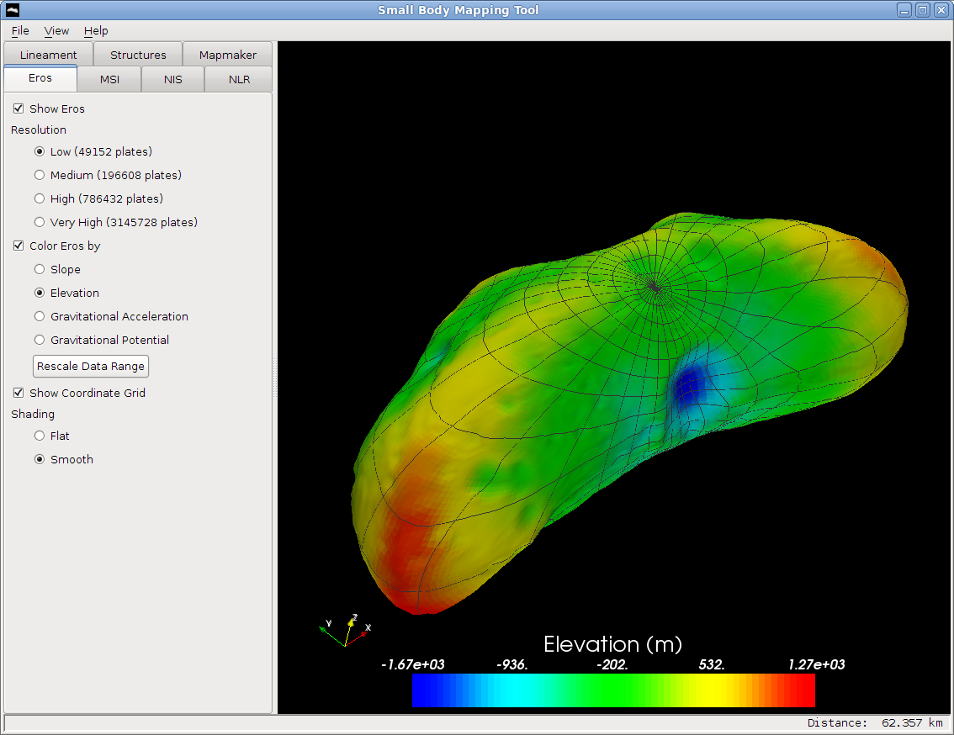
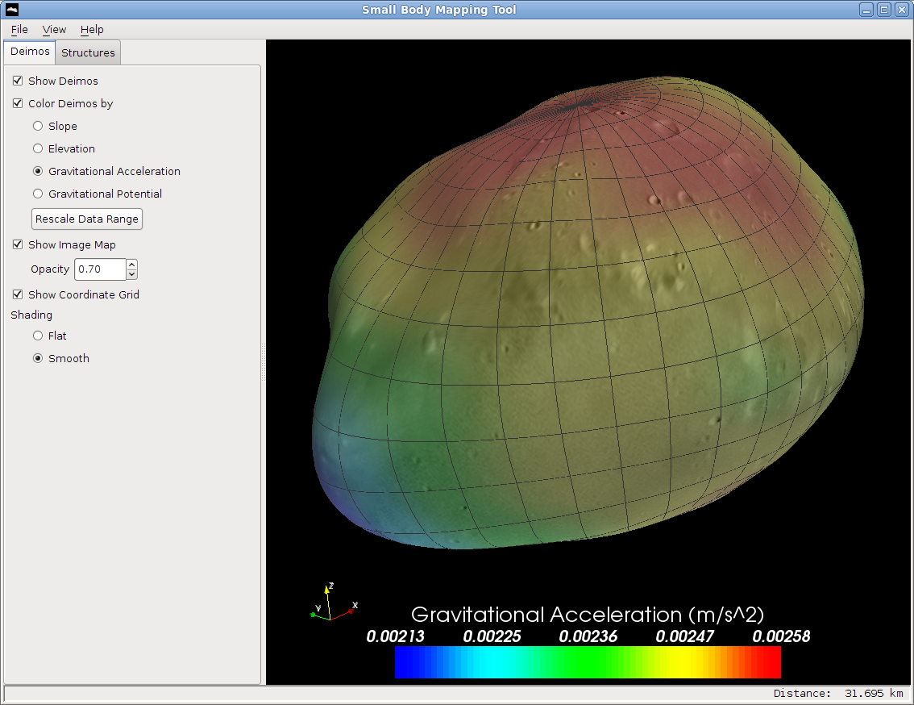
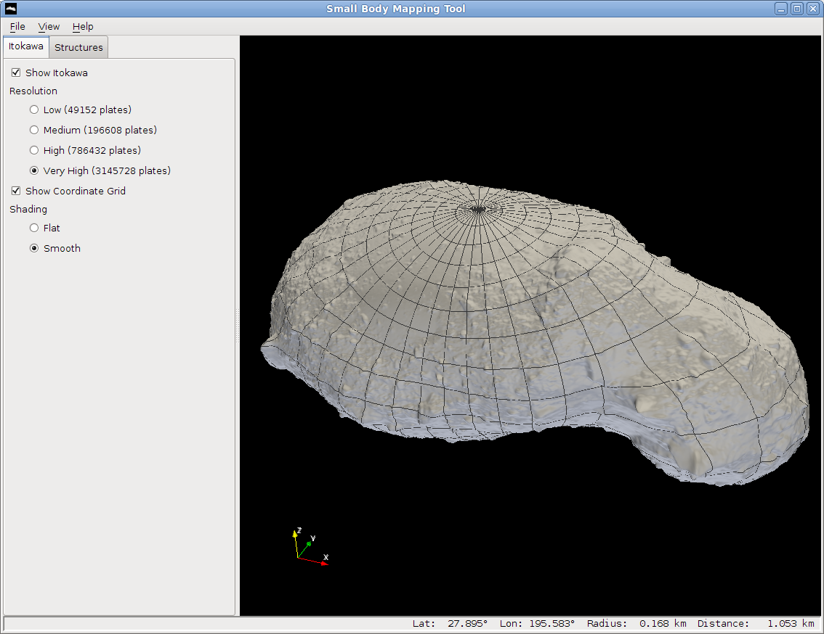
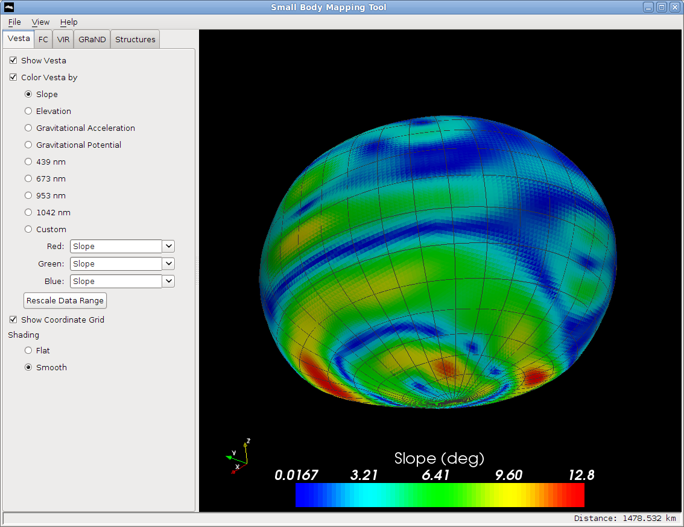
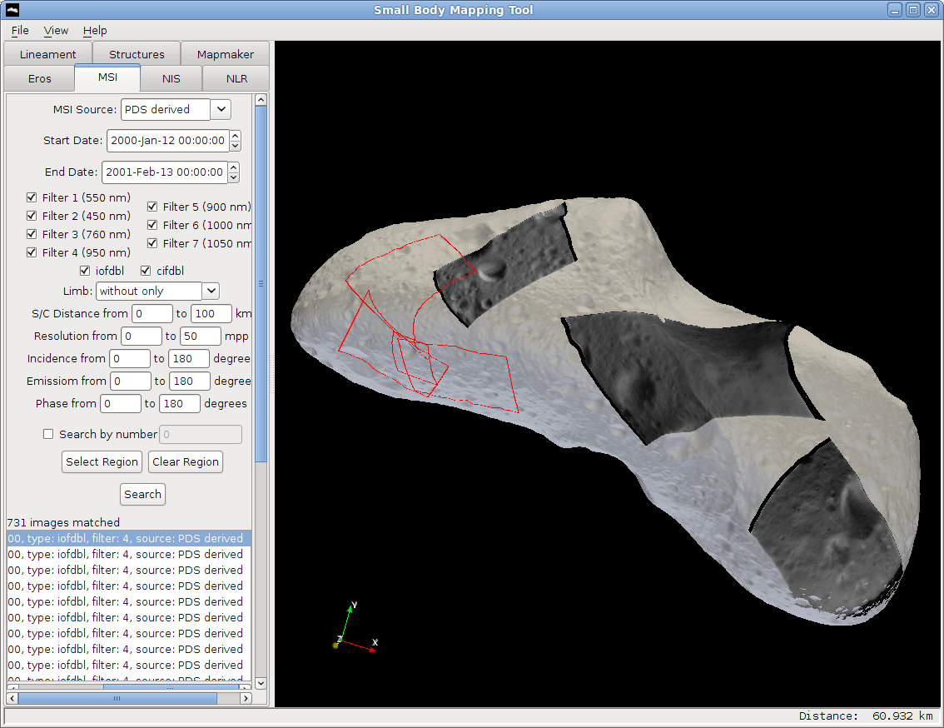
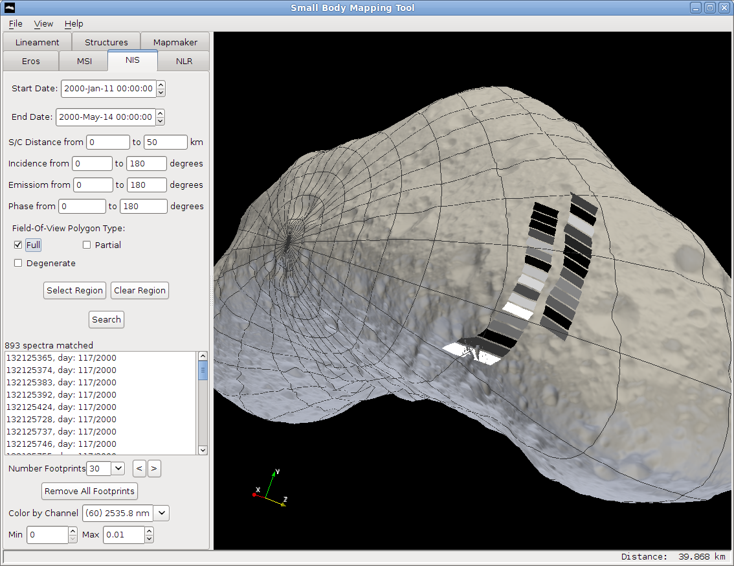
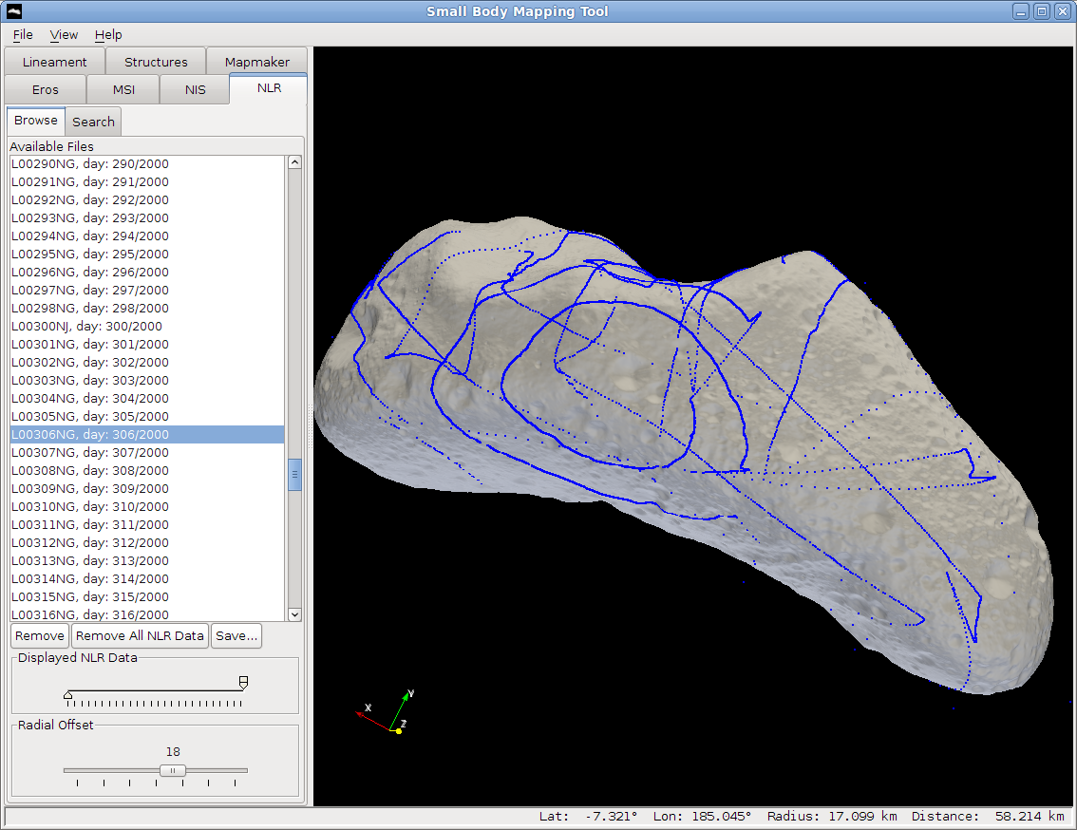
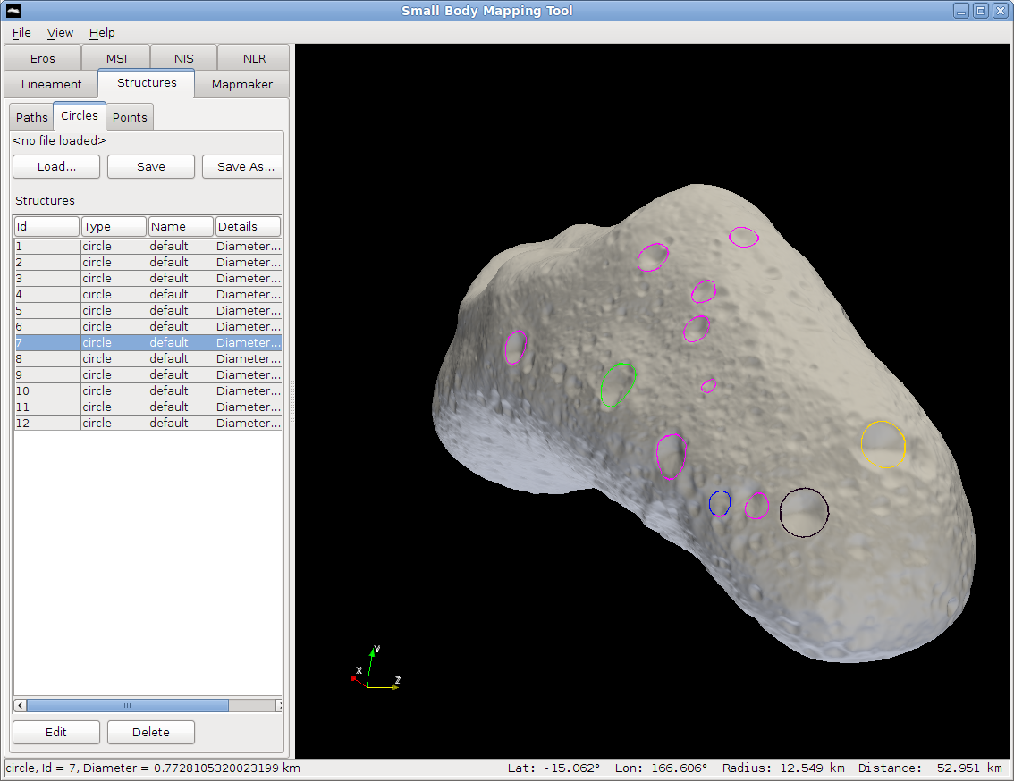
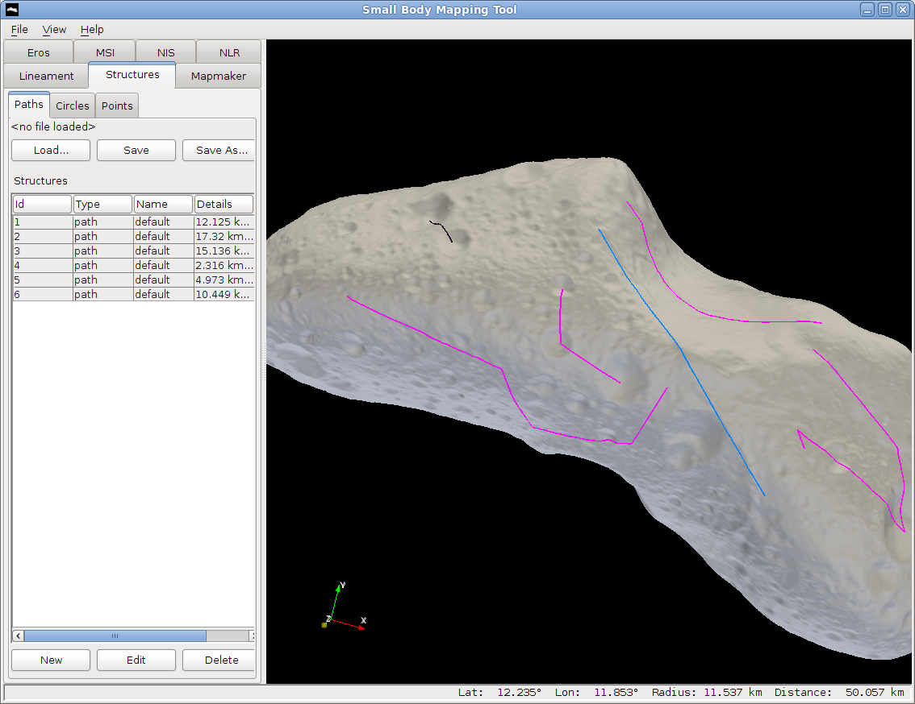
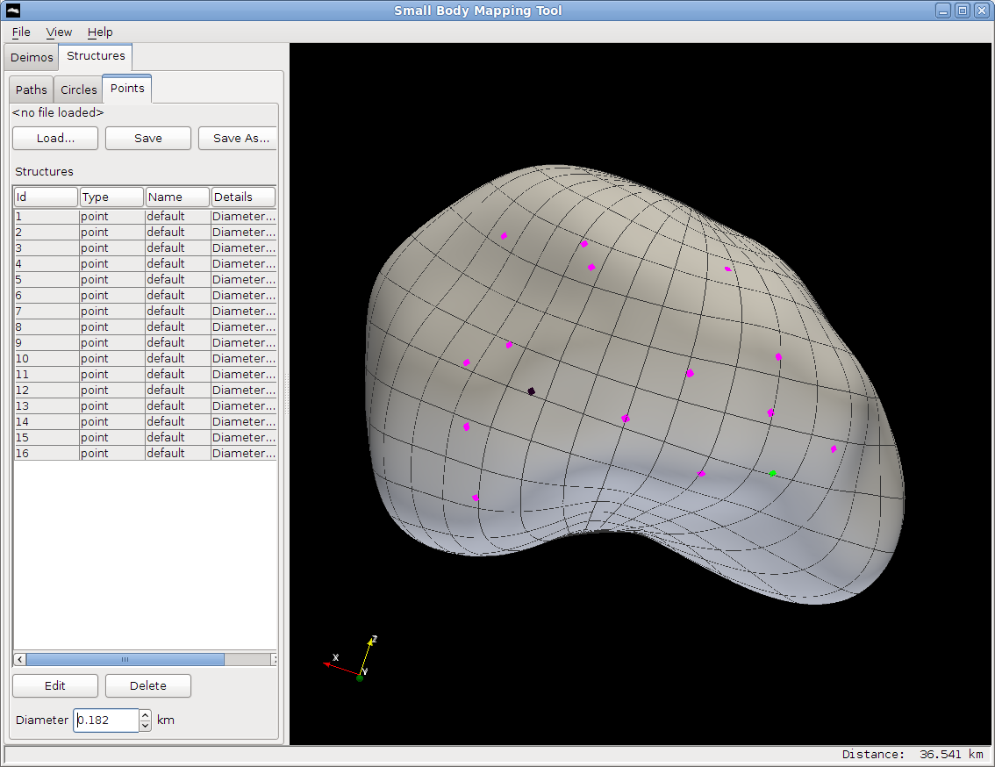
A Tool for the Visualization of Small Body Data
Eliezer G. Kahn¹, Olivier S. Barnouin¹, Debra L. Buczkowski¹, Carolyn M. Ernst¹, Noam Izenberg¹, Scott Murchie¹, Louise M. Prockter¹
¹The Johns Hopkins University Applied Physics Laboratory, 11100 Johns Hopkins Road, Laurel, MD, USA
Introduction
It is currently difficult for interested scientists and researchers to quickly analyze and interpret data returned from small body missions due in large part to the highly irregular shape of the small bodies and the distorted projection of data onto their surfaces. In addition, the large number of data files that are often in obscure and complicated formats create further obstacles.
The Small Body Mapping Tool (SBMT) was created to facilitate the harvesting and analysis of small body data. It is a 3D interactive visualization tool designed for quickly searching and visualizing such data. Written in the Java programming language, the tool runs on all major operating systems including Mac OS X, Linux, and Windows. Several screenshots of the tool are shown here highlighting some of its main features.
View small bodies
Several small body shape models are integrated in the SBMT, including Eros, Deimos, Itokawa, and Vesta. These shape models can be colored to correspond to scalar values (e.g. elevation, slope) and can be overlaid with a coordinate grid. The shape model can also be rotated, panned, and zoomed using the mouse.
Eros colored by elevation
Deimos colored by gravitational acceleration and overlaid with a semi-transparent image
Itokawa
Vesta, colored by slope
Search data
Data obtained from orbital instruments can be searched and displayed on the pertinent shape model. For example, NEAR instrument data can be searched and displayed on the Eros shape model, including the Multispectral Imager (MSI), the NEAR Infrared Spectrometer (NIS), and the NEAR Laser Rangefinder (NLR). Searches can be refined by specifying a time range, incidence, emission, phase, resolution, and other criteria.
Three MSI images are shown mapped to Eros. Outlines of several other images are shown in red
Several footprints of NIS spectra shown on Eros. The different shades of the footprints correspond to different values of one of the channels
NLR data of one day are shown on Eros
Draw structures
The tool supports measurement of fractures, troughs, ridges, or craters by drawing structures such as circles, lineaments, and points directly on the small body. The coordinates and other information about these structures can be exported to files for further analysis using other software.
Several circles drawn around Eros craters
Several lineaments drawn on Eros
Several points drawn on Deimos
Future Work
Work currently under development includes providing the capability to create color images and image mosaics from several MSI images, adding more shape models of other small bodies, adding new datasets acquired from other missions, and enhancing existing functionality overall.
Acknowledgments
This work was supported by various grants funded by the NASA Planetary Mission Data Analysis Program.
Further Information
Researchers interested in using the Small Body Mapping Tool are welcome to send an email to eliezer.kahn@jhuapl.edu.

